Slide 1
Mathematics
Ancient Era
1650 – 1548
BCE - CE
Geometry
Industrial Era
1736 – 1856
APA
Modern Era
1860 – Present
Algebra I
Renaissance Era
1564 - 1731

Slide 2
Algebra I Biography Project – Grading Rubric
Written Report:
The written report must be 250 words long and presented via Google Docs. The paper will be double spaced and typed using font size 12. It should include the title, the author and the person chosen. It should be typed and in complete sentences. The sentences should have the correct capitalization and punctuation and the spelling should be correct. It should include information about the subject’s early life, family, accomplishments, interesting facts and, if appropriate, death. At least three sources are required and will be properly cited on a separate page. The report will submitted to the “classroom” on the date agreed upon.
Oral Presentation:
The oral component of the project will be presented in class. The student will present information about the subject’s early life, family, accomplishments, interesting facts and, if appropriate, death. A Google Slides timeline, containing the same information about the person’s life, will also be required on the day of the presentation. A minimum of 5 slides is required (title slide and reference slide must be included)
Grade Points
A 24 – 20
B 19 – 15
C 14 – 10
D 9 – 5
F 4 – 0

Slide 3
Category | 4 | 3 | 2 | 1 | Total Points
Organization | Information is very organized with well-constructed paragraphs | Information is organized with well-constructed paragraphs | Information is organized, but paragraph are not well-constructed | The information appears to be disorganized
Quality of Information | Information clearly relates to the main topic. It includes more than two supporting details and/or examples. | Information clearly relates to the main topic. It provides one-two supporting details and/or examples. | Information clearly relates to the main topic. No details and/or examples are given. | Information has little or nothing to do with the main topic
Mechanics | No grammatical, spelling or punctuation errors. | Almost no grammatical, spelling or punctuation errors. | A few grammatical spelling or punctuation errors. | Many grammatical, spelling or punctuation errors.
Biography | Biography is neat well explained and shows significant research into the topic | Biography is neat; explanations are given and show the beginnings of research into the topic. | Biography is neat, very brief and explanations show very little research into the topic | Biography is not neat and /or shows no research into the topic.
Oral Communication | Student spoke loudly, clearly and made eye contact with audience during presentation. Had excellent command of knowledge | Student spoke loudly, clearly and made eye contact with audience during presentation. Had a fair command of knowledge | Students presentation was brief, unclear, failed to make eye contact during presentation. Communicated very little knowledge audience. | Student’s presentation was distracted and was unable to communicate ideas to audience
Time Line | Timeline is neat well explained and shows significant research into the topic | Timeline is neat; explanations are given and show the beginnings of research into the topic | Timeline is neat, very brief and explanations show very little research into the topic | Timeline is not neat and /or shows no research into the topic

Slide 4
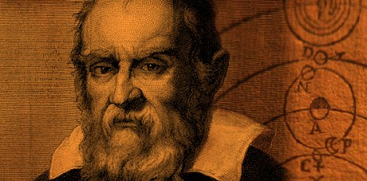
Galileo Galilei
(February 15, 1564 – January 8, 1642)
Galileo Galilei was an Italian physicist mathematician, engineer, astronomer, and philosopher who played a major role in the scientific revolution. His achievements include improvements to the telescope and major astronomical observations. He supported Copernicus’ heliocentric theory and was put under “house arrest” in his later years. Galileo has been called the “Father of Modern Science".

Slide 5
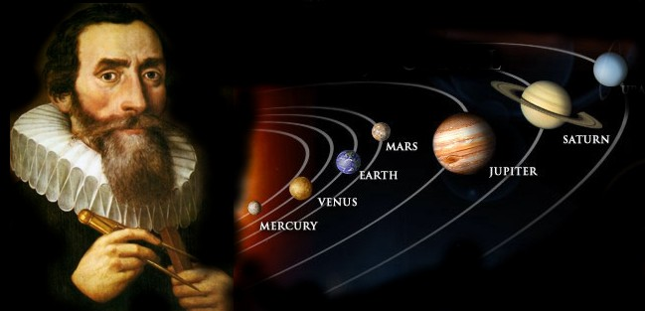
Johannes Kepler
(December 27, 1571 – November 15, 1630)
In the late sixteenth century, scientists believed that planets in the solar system traveled in circular orbits around the Earth. Kepler revealed that their paths were not perfect circles but ellipses. His descriptions of planetary motions became known as Kepler’s laws. Kepler was always sick as a child and was born into poverty. He was an assistant to astronomer Tycho Brahe. Together they worked in Brahe’s observatory in Prague where they tracked the motions of the planets and maintained the most accurate observations of the solar system at the time. Brahe was always suspicious of Kepler and never shared his notes with him. Instead, he assigned Kepler to solve the mystery of Mars, one of the most puzzling problems in astronomy at the time. Ironically, by working out this problem Kepler figured out how the entire the solar system functioned. When Brahe died in 1601 his family wanted to sell all of his work and tried to keep it from Kepler. Kepler, however, managed to acquire Brahe's observations before the family could sell them.

Slide 6
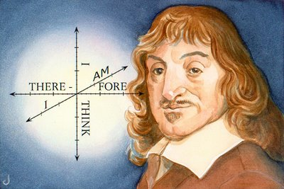
Rene Descartes
(March 31,1596 – February 11, 1650)
Rene Descartes was French Philosopher, Physicist and Mathematician. He is best known for his ‘Cogito Ergo Sum’ philosophy. He made ground breaking contributions to mathematics and helped build the foundations of modern calculus. Descartes also is famous for his development of Cartesian Geometry, known to most as the standard graph (Square grid lines, x and y axis, etc.) and its use of algebra to describe the various locations on such. Another contribution to the mathematics was the introduction of superscripts within algebra to express powers.

Slide 7
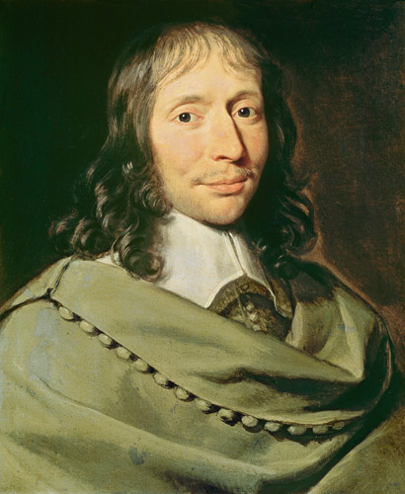
Blaise Pascal
(June 19, 1623 – August 19, 1662)
Blaise Pascal was a French mathematician, physicist, inventor, writer and Christian philosopher. He was a child prodigy who was educated by his father. Pascal was one of the first two inventors of the mechanical calculator. He is also known for his Pascal's triangle; where each number is the sum of the two directly above it. The triangle demonstrates many mathematical properties in addition to showing binomial coefficients.

Slide 8
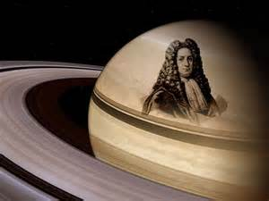
Giovanni Cassini
(June 8, 1625 – September 14, 1712)
Cassini was an Italian mathematician, astronomer, engineer, and astrologer Cassini is known for his work in the fields of astronomy and engineering. Cassini most notably discovered four satellites of the planet Saturn and noted the division of the rings of Saturn.

Slide 9
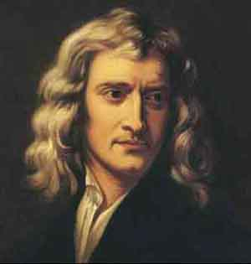
Isaac Newton
(December 25, 1642 – March 20, 1727)
Newton was an English physicist and mathematician. He wrote the laws of motion, the laws of optics, wrote a book called the Mathematical Principles of Natural Philosophy, laid the foundations for classical mechanics, invented Calculus practically on a dare, then turned 26.

Slide 10
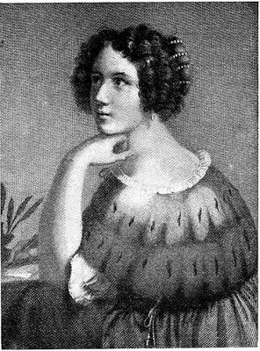
Elena C. Piscopia
(June 5, 1646 – July 26, 1684)
Elena Piscopia was a Venetian philosopher of noble descent, and one of the first women to receive a doctoral degree from a university. She was born into a noble Venetian family and at age seven, Elena Piscopia received tutoring. She was tutored in the classical languages of Latin and Greek, as well as grammar and music. By age seventeen Elena was considered to be an expert musician. She became a mathematics lecturer at the University of Padua in 1678.

Slide 11
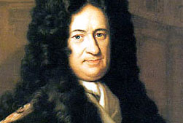
Gottfried Leibniz
(July 1, 1646 – November 14, 1716)
Gottfried Leibniz was a German mathematician and philosopher. Leibniz developed calculus along with Isaac Newton. He became one of the most prolific inventors in the field of mechanical calculators. While working on adding automatic multiplication and division to Pascal's calculator He introduced several notations used to this day, for instance the integral sign ∫ representing an elongated S, from the Latin word summa and the d used for differentials, from the Latin word differentia.

Slide 12
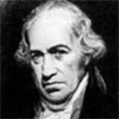
Daniel Gabriel Fahrenheit
(May 14,1686– September 16, 1736)
Fahrenheit was a German instrument maker. He created the first reliable thermometers. He was one of five children and sadly both his parents died on the same day when he was 15 from eating poisonous mushrooms. Soon after, he was sent to Amsterdam to work for and learn from a shopkeeper. After completing a term of four years there, Fahrenheit became interested in making scientific instruments. Although he lived in Amsterdam most of his life, he traveled a lot to observe the work of scientists and instrument makers in other areas. He spent most of his time in England, where he became a member of the Royal Society (Great Britain's oldest organization of scientists).

Slide 13
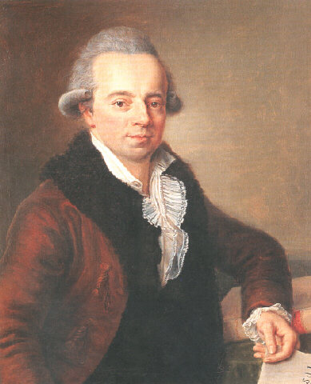
Daniel Bernoulli
(February 8, 1700 – March 17, 1782)
Bernoulli was a Swiss mathematician and physicist and was one of the many prominent mathematicians in the Bernoulli family. He is particularly remembered for his applications of mathematics to mechanics, especially fluid mechanics, and for his pioneering work in probability and statistics. His name is commemorated in the Bernoulli principle, a particular example of the conservation of energy, which describes the mathematics of the mechanism underlying the operation of two important technologies of the 20th century: the carburetor and the airplane wing.

Slide 14
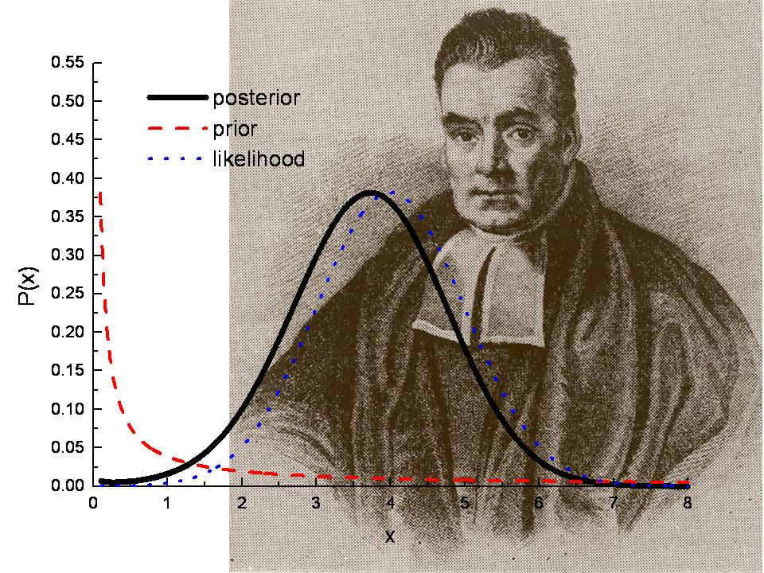
Thomas Bayes
(1701 – April 7, 1761)
Bayes was an English philosopher and mathematician. He specialized in the area of probability and statistics.

Slide 15
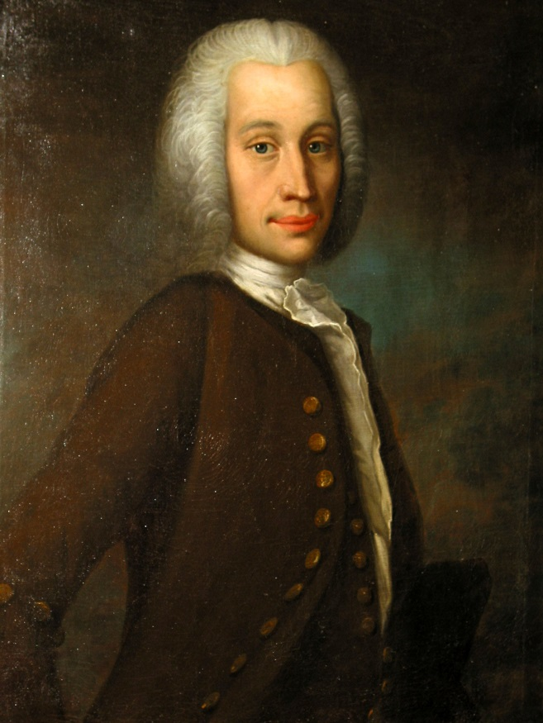
Anders Celsius
(November 27, 1701 –1744)
Anders Celsius was a Swedish astronomer who is known for inventing the Celsius temperature scale, which set the freezing point of water at 0° and the boiling point at 100°.
Celsius also built the Uppsala Astronomical Observatory in 1740, the oldest astronomical observatory in Sweden.
He is also considered to be the first astronomer to analyze the changes of the earth’s magnetic field at the time of a northern light and assess the brightness of stars with measuring tools.
Sadly, he died of tuberculosis in 1744 at the age of 43

Slide 16
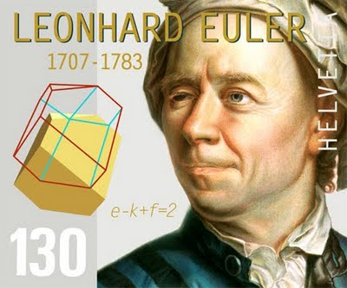
Leonhard Euler
(April 15, 1707 – September 18, 1783)
Euler was a pioneering, smart-as-Einstein, Swiss mathematician and physicist. He made important discoveries in fields of infinitesimal calculus and graph theory. He also introduced much of the modern mathematical terminology and notation, such as the notion of a mathematical function f(x) and the symbol for pi. He is also renowned for his work in mechanics, fluid dynamics, optics, astronomy, and music theory. His work is the one main reason why the industrial and technological developments increased rapidly while he was alive.

Slide 17
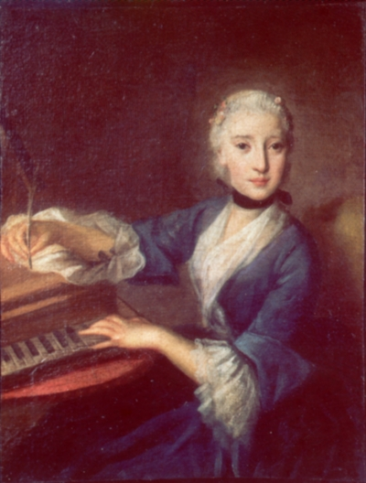
Maria Agnesi
(May 16, 1718 – January 9, 1799)
Agnesi was an Italian mathematician and philosopher. She was the oldest of 21 children and a child prodigy who studied languages and math. She wrote a textbook to explain math to her brothers which became the first book to discuss both differential and integral calculus. She was the first woman appointed a university professor of mathematics at the University of Bologna.

Slide 18
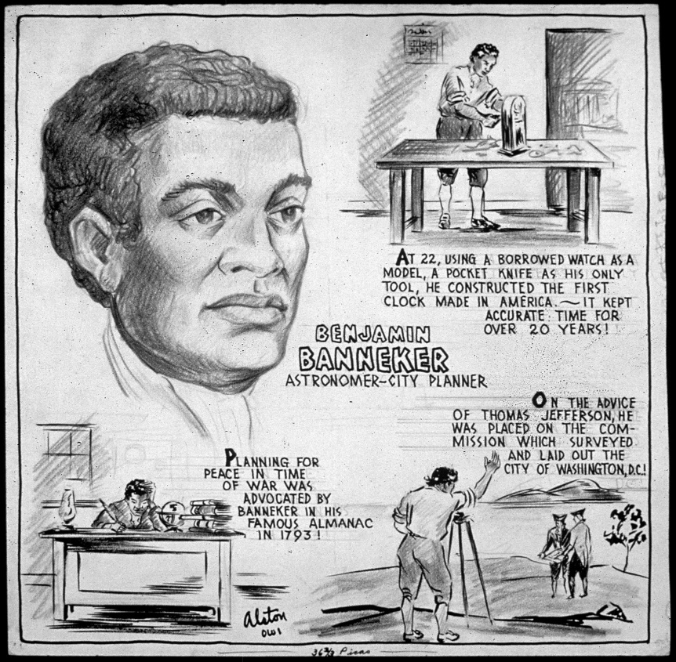
Benjamin Banneker
(November 9, 1731 – October 9, 1806)
Banneker's English grandmother immigrated to the Baltimore area and married one of her slaves. Later, their daughter did likewise, and gave birth to Benjamin in 1731. Since by law, free/slave status depended on the mother, Banneker, like his mother, was free.
When he was 22, he was given a pocket watch. He then took it apart and used it as a model to build his own clock, made entirely of wood. This was the first clock built in the New World and it kept perfect time for forty years.
During the Revolutionary War, wheat grown on a farm designed by Banneker helped save the U.S. troops from starving. After the War, he took up astronomy and in 1789, he successfully predicted an eclipse. From 1792 to 1802, Banneker published an annual Farmer's Almanac, for which he did all the calculations himself.
He is most famous for designing the layout of Washington, D.C. After a year of work, a Frenchman hired by George Washington to design the capital, L'Enfant, quit, and took all the plans. Thomas Jefferson asked Banneker to take over the project and was placed on the planning committee. In two days, Banneker reproduced a complete layout of the streets, parks, and major buildings from memory. He was a polymath: farmer, engineer, surveyor, city planner, astronomer, mathematician, inventor, author, and social critic.

Slide 19
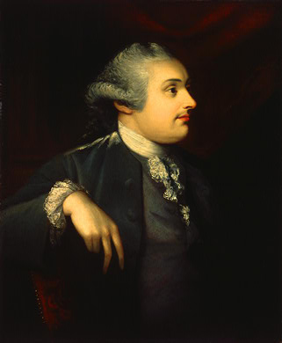
Henry Cavendish
(October 10, 1731 – February 24, 1810)
Cavendish was a British natural philosopher, scientist, and an important experimental and theoretical chemist and physicist. Cavendish is famous for his discovery of hydrogen or what he called "inflammable air". He was extremely shy and worked meticulously on his experiments. He always displayed great accuracy and precision while conducting his research. His successful experiment to weigh the Earth is known as the Cavendish Experiment.

