Slide 1
Mathematics
Ancient Era
1650 – 1548
BCE - CE
Geometry
Industrial Era
1736 – 1856
APA
Modern Era
1860 – Present
Algebra I
Renaissance Era
1564 - 1731

Slide 2
APA Biography Project – Grading Rubric
Written Report:
The written report must be 250 words long and presented via Google Docs. The paper will be double spaced and typed using font size 12. It should include the title, the author and the person chosen. It should be typed and in complete sentences. The sentences should have the correct capitalization and punctuation and the spelling should be correct. It should include information about the subject’s early life, family, accomplishments, interesting facts and, if appropriate, death. At least three sources are required and will be properly cited on a separate page. The report will submitted to the “classroom” on the date agreed upon
Oral Presentation:
The oral component of the project will be presented in class. The student will present information about the subject’s early life, family, accomplishments, interesting facts and, if appropriate, death. A Google Slides timeline, containing the same information about the person’s life, will also be required on the day of the presentation.
Grade Points
A 24 – 20
B 19 – 15
C 14 – 10
D 9 – 5
F 4 – 0

Slide 3
Category | 4 | 3 | 2 | 1 | Total Points
Organization | Information is very organized with well-constructed paragraphs | Information is organized with well-constructed paragraphs | Information is organized, but paragraph are not well-constructed | The information appears to be disorganized
Quality of Information | Information clearly relates to the main topic. It includes more than two supporting details and/or examples. | Information clearly relates to the main topic. It provides one-two supporting details and/or examples. | Information clearly relates to the main topic. No details and/or examples are given. | Information has little or nothing to do with the main topic
Mechanics | No grammatical, spelling or punctuation errors. | Almost no grammatical, spelling or punctuation errors. | A few grammatical spelling or punctuation errors. | Many grammatical, spelling or punctuation errors.
Biography | Biography is neat well explained and shows significant research into the topic | Biography is neat; explanations are given and show the beginnings of research into the topic. | Biography is neat, very brief and explanations show very little research into the topic | Biography is not neat and /or shows no research into the topic.
Oral Communication | Student spoke loudly, clearly and made eye contact with audience during presentation. Had excellent command of knowledge | Student spoke loudly, clearly and made eye contact with audience during presentation. Had a fair command of knowledge | Students presentation was brief, unclear, failed to make eye contact during presentation. Communicated very little knowledge audience. | Student’s presentation was distracted and was unable to communicate ideas to audience
Time Line | Timeline is neat well explained and shows significant research into the topic | Timeline is neat; explanations are given and show the beginnings of research into the topic | Timeline is neat, very brief and explanations show very little research into the topic | Timeline is not neat and /or shows no research into the topic

Slide 4
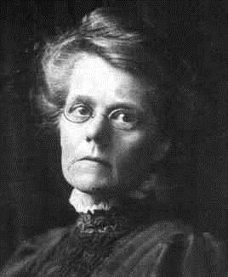
Alicia Scott
(June 8, 1860 - December 17, 1940)
Alicia Scott was an English mathematician. She was taught by her mother and never had any formal education. Alicia excelled in four-dimensional geometry. She is most famous for her translations of Platonic and Archimedean solids into higher dimensions.

Slide 5
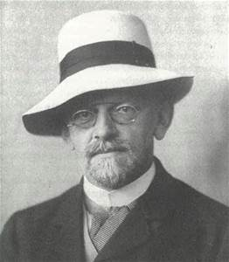
David Hilbert
(January 23, 1862 – February 14, 1943)
David Hilbert was a German mathematician. He is recognized as one of the most influential and universal mathematicians of the 19th and early 20th centuries. He helped establish the foundation of functional analysis.

Slide 6
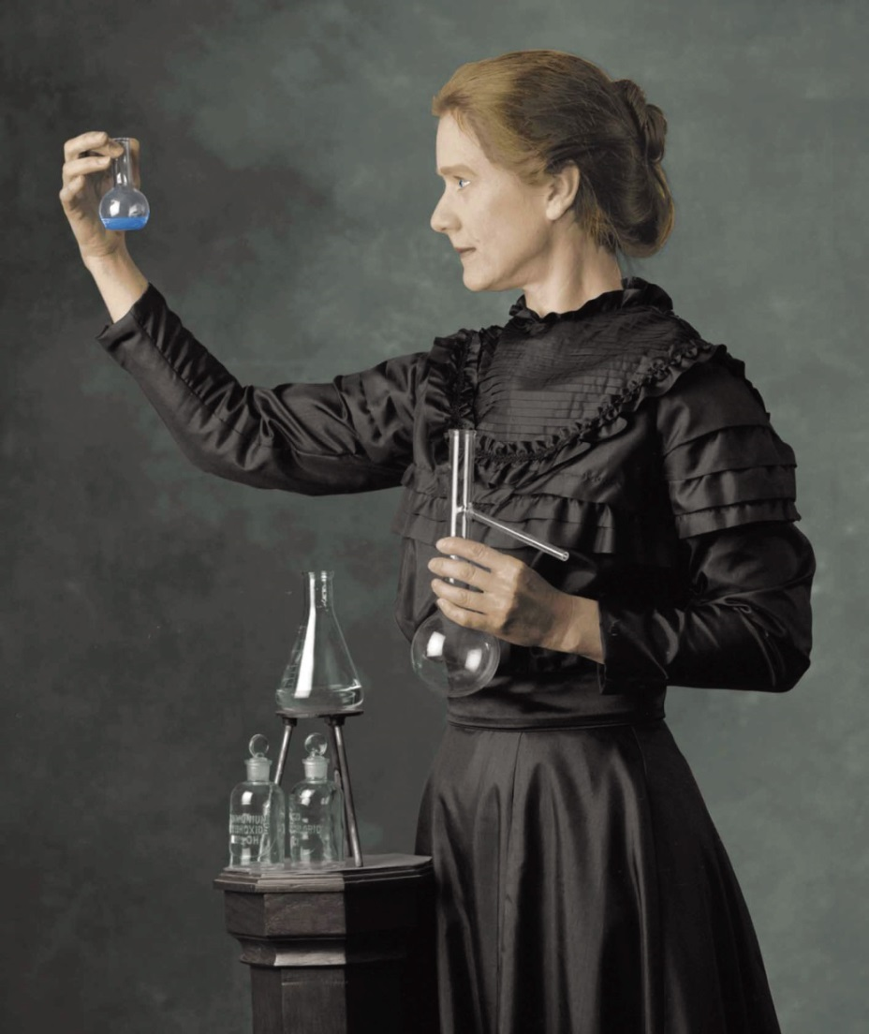
Marie Curie
(November 7, 1867 – July 4, 1934)
Marie Curie was a Polish and naturalized-French physicist and chemist who conducted pioneering research on radioactivity. She was the first woman to win a Nobel Prize, the only woman to win in two fields, and the only person to win in multiple sciences. She was also the first woman to become a professor at the University of Paris

Slide 7
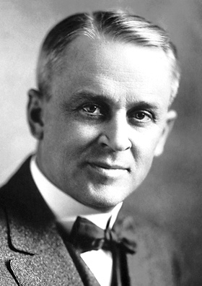
Robert A. Millikan
(March 22, 1868 – December 19, 1953)
American physicist Robert A. Millikan is best known for measuring the charge on the electron, for which he won the Nobel Prize in Physics in 1923. He also was able to obtain the exact value of Planck's constant.

Slide 8
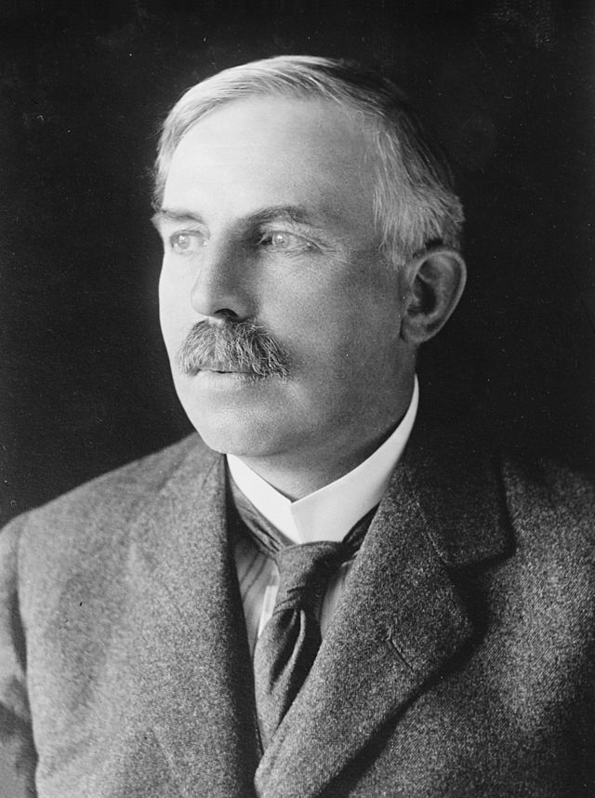
Ernest Rutherford
(August 30, 1871 – October 19, 1937)
Ernest Rutherford was a New Zealand-born British physicist who is known as the father of nuclear physics. He won the Nobel Prize in Chemistry in 1908 for his model of the atom. He discovered the atomic nucleus and said that was similar to the solar system. Like planets, electrons orbited a central, sun-like nucleus. He was also the first human to create a "nuclear reaction."

Slide 9
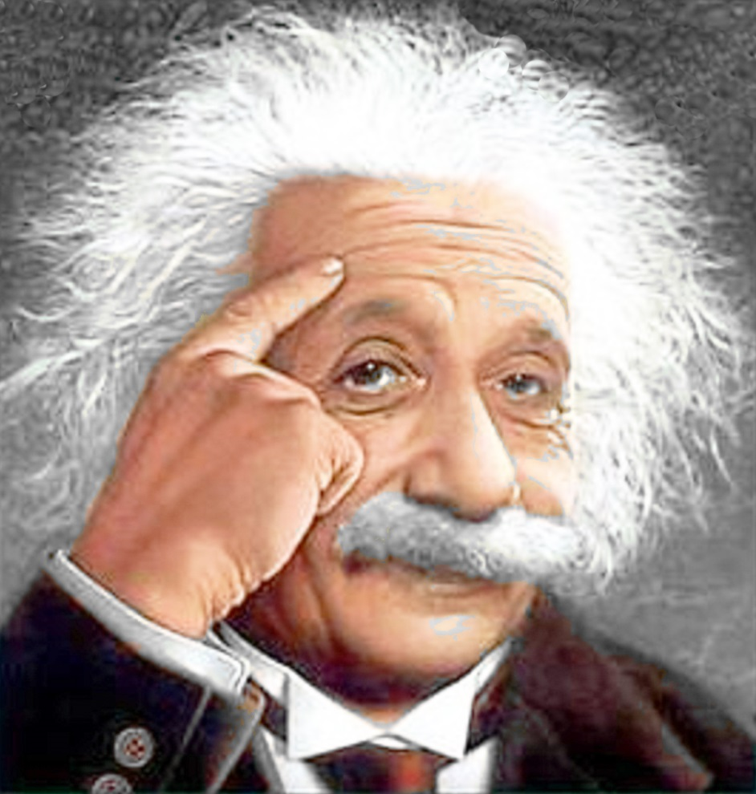
Albert Einstein
(March 14, 1879 – April 18, 1955)
Einstein was a German-born theoretical physicist theoretical physicist. He developed the general theory of relativity and quantum mechanics. He is best known for his formula E = mc² (which has been dubbed "the world's most famous equation"). He received the 1921 Noble Prize in Physics

Slide 10
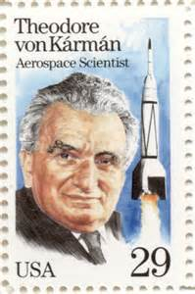
Theodore Von Karman
(May 11, 1881 – May 6, 1963)
Theodore von Karman was a Hungarian – American mathematician, aerospace engineer and physicist. He was active in the fields of aeronautics and astronautics. He is responsible for many key advances in aerodynamics, especially his work on supersonic and hypersonic airflow

Slide 11
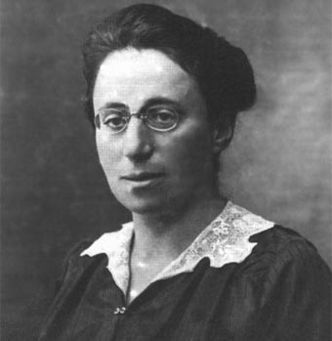
Emmy Noether
(March 23, 1882 – April 14, 1935 )
Emmy Noether was a German, Jewish, American mathematician. Albert Einstein called her "the most significant creative mathematical genius thus far produced since the higher education of women began." Noether escaped Germany when the Nazis took over, and taught in America for several years before her unexpected death.

Slide 12
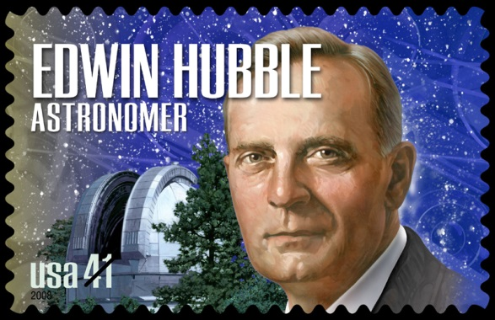
Edwin Hubble
(November 20, 1889 – September 28, 1953)
Edwin Hubble was an American astronomer who played a crucial role in establishing the field of extragalactic astronomy and is generally regarded as one of the most important observational cosmologists of the 20th century. Hubble is known for showing that the recessional velocity of a galaxy increases with its distance from the earth, implying the universe is expanding, known as "Hubble’s Law. Hubble supported the Doppler shift interpretation of the observed redshift, which led to the theory of the metric expansion of space.

Slide 13
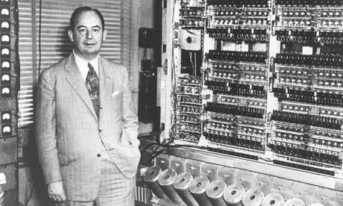
John Von Neumann
(December 28, 1903 – February 8, 1957)
John von Neumann was a Hungarian-American pure and applied mathematician, physicist and polymath. He was one of the main members of the member of the Manhattan Project. He also was important in the development of game theory and the digital computer.

Slide 14
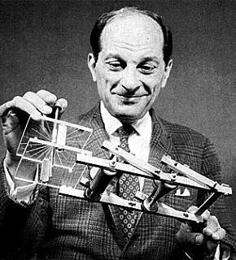
Stanislaw Ulan
(April 13, 1909 – May 13, 1984)
Stanislaw Ulan was a Polish-American mathematician. He participated in America's Manhattan Project and designed some of the first thermonuclear weapons. He was also one of the first people to suggest the idea of nuclear pulse propulsion.

Slide 15
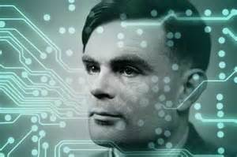
Alan Turing
(June 23, 1912 – June 7, 1954)
Computer Scientist and Cryptanalyst, Alan Turing is one of the greatest minds of the 20th Century. During the Second World War he worked in the Government Code and Cypher School in Britain and cracked the German Enigma Encryptions. After the end of the war he invested his time in computing. He came up with the idea of a computing style machine before the war and he is considered one of the first true computer scientists. Furthermore, he wrote a range of brilliant papers on the subject of computing that are still relevant today, notably on Artificial Intelligence, on which he developed the Turing test which is still used to evaluate a computers ‘intelligence’.

Slide 16
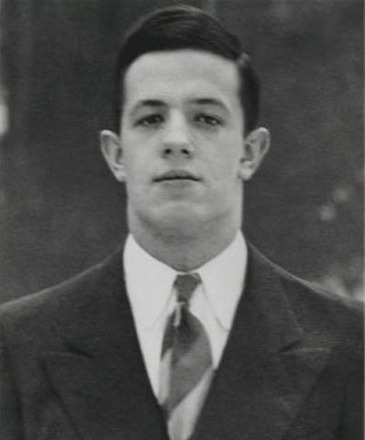
John Nash
(Born June 13, 1928)
John Nash is an American mathematician whose works in game theory, differential geometry, and partial differential equations have helped to understand how complex systems in our daily lives operate. His theories are used in market economics, computing, evolutionary biology, artificial intelligence, accounting, politics and military theory. Serving as a Senior Research Mathematician at Princeton University during the latter part of his life, he shared the 1994 Nobel Memorial Prize in Economic Science with another game theorist. Nash is in addition to being a mathematical genius is also a schizophrenic.

Slide 17
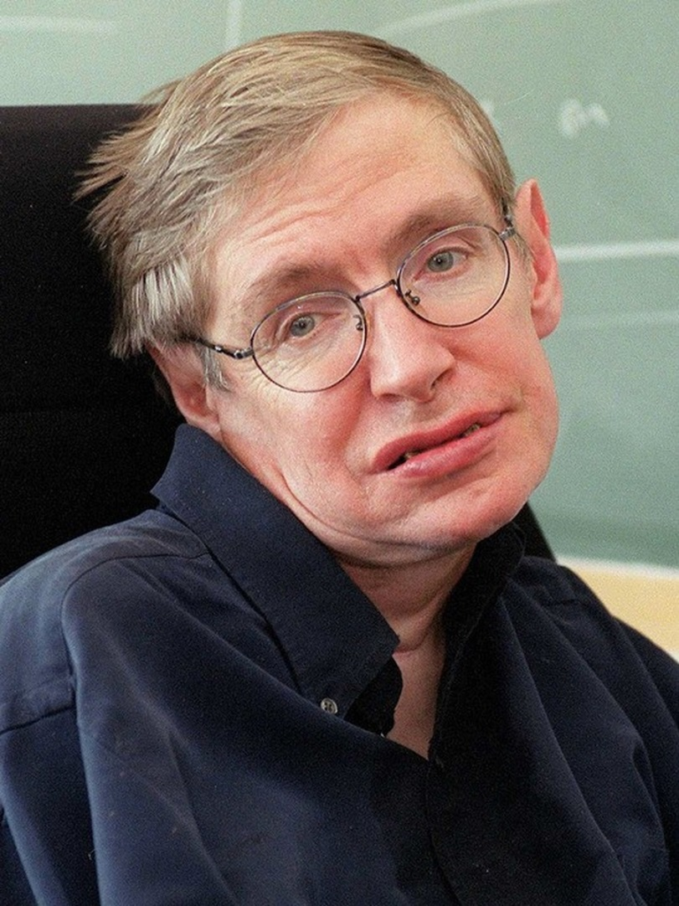
Steven Hawking
(Born January 8, 1942)
Steven Hawking is an English theoretical physicist, cosmologist, author and Director of Research at the Centre for Theoretical Cosmology within the University of Cambridge. Hawking is famous for his theoretical prediction that black holes emit radiation, called Hawking radiation. He was also the first to combine the general theory of relativity and quantum mechanics. Hawking has a motor neuron disease related to amyotrophic lateral sclerosis (ALS), a condition that has progressed over the years. He is almost entirely paralyzed and communicates through a speech generating device. He married twice and has three children.

Slide 18
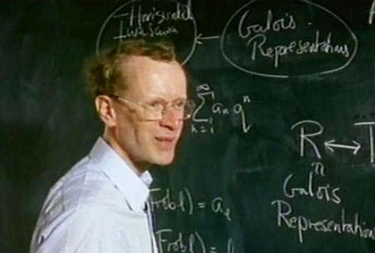
Andrew Wiles
(Born April 11, 1953 )
Andrew Wiles is a British mathematician and is most well-known for his proof of Fermat’s Last Theorem. Although the contributions to math are not as grand as others, he did ‘invent’ large portions of new mathematics for his proof of the theorem. He is extremely dedicated to finding solutions. Wiles literally shut himself away for 7 years to formulate a solution to a problem. When it was found that the solution contained an error, he returned to solitude for another year before he corrected the solution. His proof is so intelligent that only a few people in the world can understand it and as time passes more and more people will understand its greatness.

Slide 19
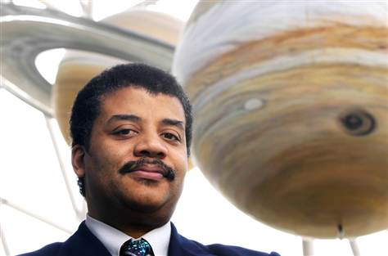
Neil Degrasse Tyson
(Born October 5, 1958)
Neil Tyson is an American astrophysicist, author, and science communicator. He is currently the Frederick P. Rose Director of the Hayden Planetarium at the Rose Center for Earth and Space and a research associate in the department of astrophysics at the American Museum of Natural History.

