Slide 1
Geometry Biography Project – Grading Rubric
Written Report:
The written report must be 250 words long. The paper will be double spaced and typed using font size 12. It should include the title, the author and the person chosen. It should be typed and in complete sentences. The sentences should have the correct capitalization and punctuation and the spelling should be correct. It should include information about the subject’s early life, family, accomplishments, interesting facts and, if appropriate, death. At least three sources are required and will be properly cited on a separate page. The report will be handed in on the date agreed upon.
Oral Presentation:
The oral component of the project will be presented in class. The student will present information about the subject’s early life, family, accomplishments, interesting facts and, if appropriate, death. A written timeline, containing the same information about the person’s life, will also be required on the day of the presentation.
Grade Points
A 24 – 20
B 19 – 15
C 14 – 10
D 9 – 5
F 4 – 0

Slide 2
Category | 4 | 3 | 2 | 1 | Total Points
Organization | Information is very organized with well-constructed paragraphs | Information is organized with well-constructed paragraphs | Information is organized, but paragraph are not well-constructed | The information appears to be disorganized
Quality of Information | Information clearly relates to the main topic. It includes more than two supporting details and/or examples. | Information clearly relates to the main topic. It provides one-two supporting details and/or examples. | Information clearly relates to the main topic. No details and/or examples are given. | Information has little or nothing to do with the main topic
Mechanics | No grammatical, spelling or punctuation errors. | Almost no grammatical, spelling or punctuation errors. | A few grammatical spelling or punctuation errors. | Many grammatical, spelling or punctuation errors.
Biography | Biography is neat well explained and shows significant research into the topic | Biography is neat; explanations are given and show the beginnings of research into the topic. | Biography is neat, very brief and explanations show very little research into the topic | Biography is not neat and /or shows no research into the topic.
Oral Communication | Student spoke loudly, clearly and made eye contact with audience during presentation. Had excellent command of knowledge | Student spoke loudly, clearly and made eye contact with audience during presentation. Had a fair command of knowledge | Students presentation was brief, unclear, failed to make eye contact during presentation. Communicated very little knowledge audience. | Student’s presentation was distracted and was unable to communicate ideas to audience
Time Line | Timeline is neat well explained and shows significant research into the topic | Timeline is neat; explanations are given and show the beginnings of research into the topic | Timeline is neat, very brief and explanations show very little research into the topic | Timeline is not neat and /or shows no research into the topic

Slide 3
Pre Algebra
Ancient Era
1650 – 1548
BCE - CE
Geometry
Industrial Era
1736 – 1856
Algebra II
Modern Era
1860 – Present
Algebra I
Renaissance Era
1564 - 1731

Slide 4
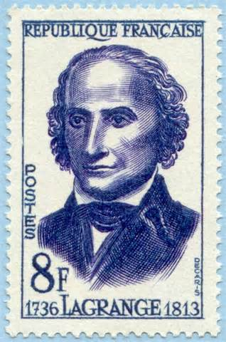
Joseph Lagrange
(January 5, 1736 - April 10, 1813)
Lagrange was an Italian Enlightenment Era mathematician and astronomer. He made significant contributions to the fields of analysis, number theory, and both classical and celestial mechanics.

Slide 5
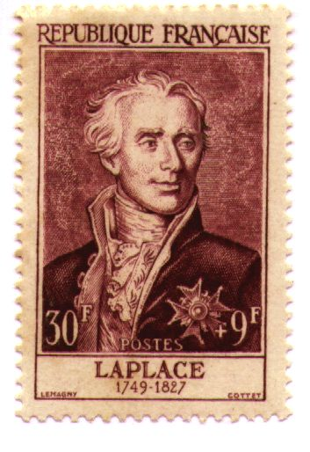
Pierre-Simon Laplace
(March 23, 1749 – March 5, 1827)
Laplace was a French mathematician and astronomer whose work was pivotal to the development of mathematical astronomy and statistics. He was one of the first scientists to suggest the existence of black holes and the notion of gravitational collapse. He also questioned the theory on the origin of the solar system.

Slide 6
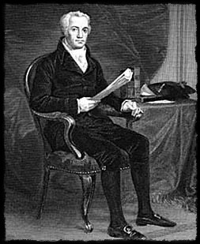
William Playfair
(September 22, 1759 – February 11, 1823)
William Playfair was a Scottish engineer and political economist, the founder of graphical methods of statistics. He invented four types of diagrams: in 1786 the line graph and bar chart of economic data and in 1801 the pie chart and circle graph, used to show part-whole relations.

Slide 7
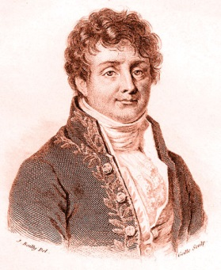
Joseph Fourier
(March 21, 1768 – May 16, 1830)
Joseph Fourier was a French mathematician and physicist born in Auxerre and best known for initiating the investigation of Fourier Seris and their applications to problems of heat transfer and vibrations. Fourier is also generally credited with the discovery of the greenhouse effect.

Slide 8
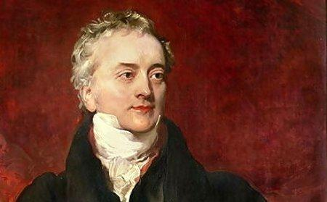
Thomas Young
(June 13, 1773 – May 10, 1829)
Thomas Young was an English physician and physicist. While a medical student, he discovered the way in which the lens of the eye changes shape to focus on objects at differing distances. He also calculated the approximate wavelengths of the seven colors discovered by Newton. Young also did work on measuring the size of molecules and was the first to use the word “energy” scientifically. In his spare time he was an Egyptologist and he helped to decipher a large part of the Rosetta Stone.

Slide 9
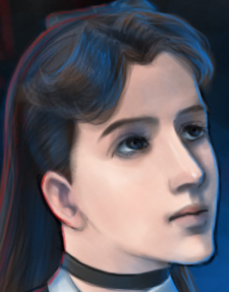
Sophie Germain
(April 1, 1776 – June 27, 1831)
Sophie Germain was a French mathematician. She studied geometry to escape boredom during the French Revolution when she was confined to her family's home, and went on to do important work in mathematics, especially her work on Fermat's Last Theorem.

Slide 10
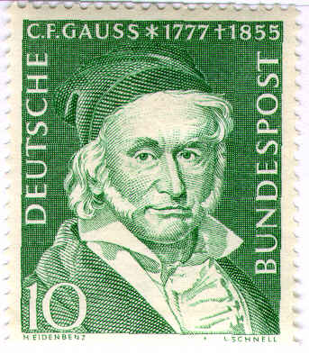
Carl Friedrich Gauss
(April 30, 1777 – February 23, 1855)
Child prodigy Gauss, the ‘Prince of Mathematics, made his first major discovery as a teenager. He wrote a famous book called Disquisitiones Arithmeticae at 21. While in kindergarten Gauss added the numbers 1 to 100 within seconds with the help of a clever trick. The local Duke sent him to the most prestigious mathematical university in the world and graduated at the age of 22. He went on to prove the fundamental theorem of algebra, and introduced the Gaussian gravitational constant in physics, as well as much more – all this before he was 24! He continued his work up until his death at the age of 77, and had made major advances in mathematics.

Slide 11
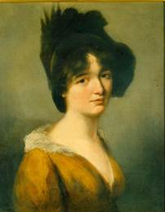
Mary Somerville
(December 26, 1780 – November 28, 1872)
Mary Somerville was a Scottish mathematician, known as the "Queen of Nineteenth Century Science." She fought family opposition to her study of math, and not only produced her own writings on theoretical and mathematical science; she produced the first geography text in England.

Slide 12
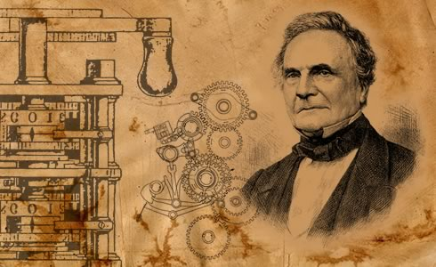
Charles Babbage
(December 26, 1791 – October 18, 1871)
Charles Babbage was an English polymath. He was a mathematician, philosopher, inventor and mechanical engineer who is best remembered for originating the concept of a programmable computer.

Slide 13
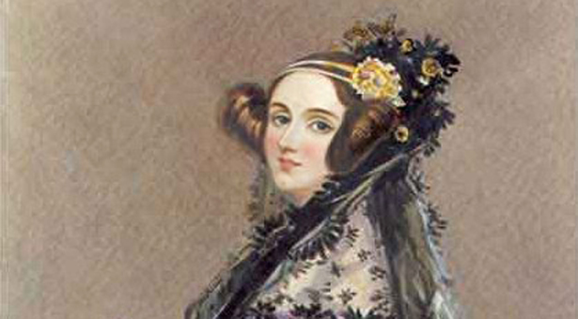
Ada Lovelace
(December 10, 1815 – November 27, 1852)
Ada Lovelace was a British mathematician and the daughter of Byron, the poet. She translated Charles Babbage’s notations into what we today call software. In 1980, the Ada computer language was name after Ada Lovelace.

Slide 14
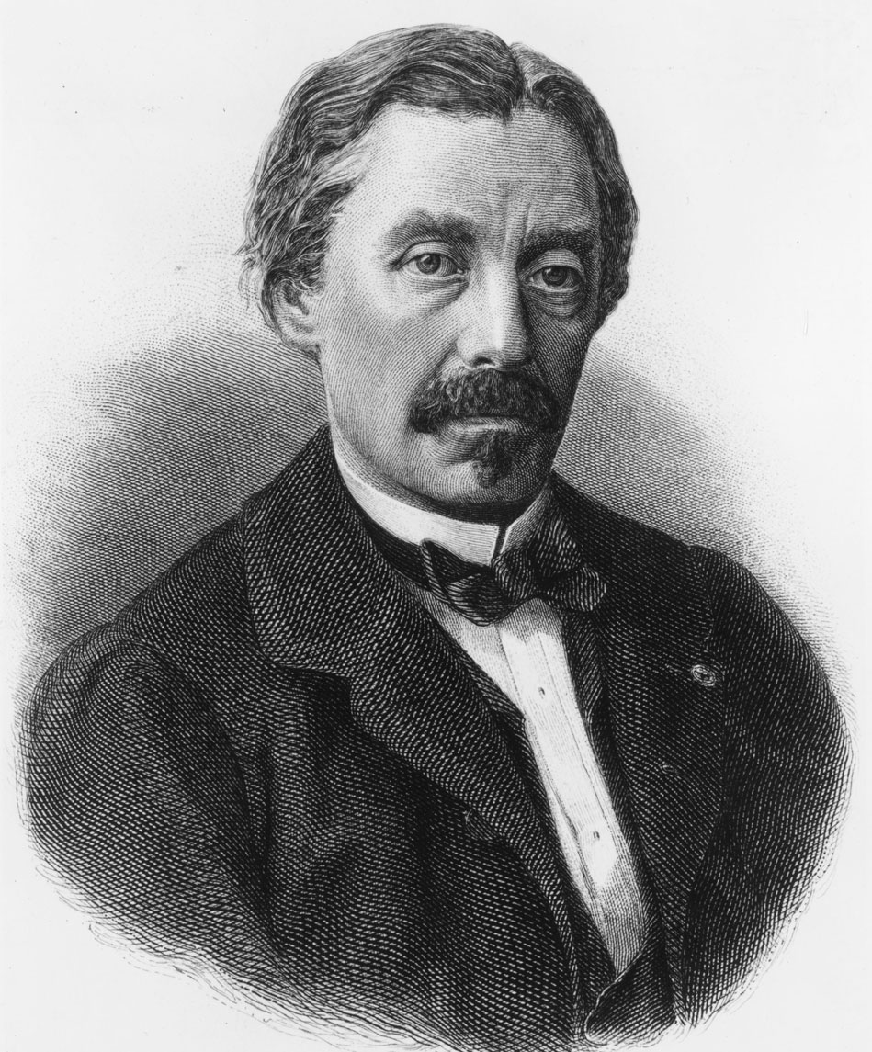
Jean Bernard Léon Foucault
(September 18, 1819 – February 11, 1868)
was a French physicist best known for his demonstration of the Foucault pendulum,

Slide 15
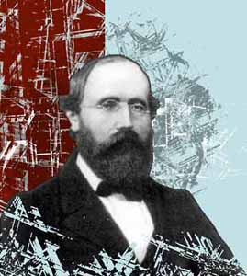
Bernhard Riemann
(September 17, 1826 – July 20, 1866)
Bernhard Riemann was an influential German mathematician who made lasting contributions to analysis, number theory, and differential geometry, some of them enabling the later development of general relativity. He is famous for his legendarily difficult Riemann Hypothesis. It is an extremely complex problem dealing with prime numbers. It was ignored at first because very few mathematicians were able to understand it at the time. Today it is considered one of the greatest open questions in modern science. It continues to baffle even the greatest mathematicians. If the problem is ever solved or proved, major encryption systems, thought to be unbreakable, would collapse.

Slide 16
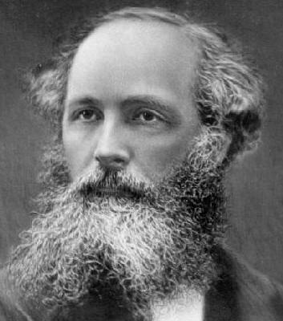
James Maxwell
(June 13, 1831 – November 5, 1879)
James Maxwell was a Scottish mathematical physicist. He is famous for developing a set of equations that describe electricity, magnetism, and optics. Maxwell demonstrated that electric and magnetic fields travel through space as waves moving at the speed of light. The unification of light and electrical phenomena led to the prediction of the existence of radio waves.

Slide 17
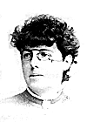
Charlotte Agnes Scott
(June 8, 1858 – November 10, 1931)
Charlotte Scott was an English, American mathematician and educator. She was raised in a supportive family that encouraged her education and she became the first head of the math department at Bryn Mawr College. She is also famous for her work to standardize testing for college entrance, which resulted in the formation of the College Entrance Examination Board.

Slide 18
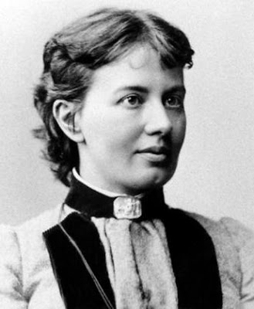
Sofia Kovalevskaya
(January 15, 1850 – February 10, 1891)
Sofia Kovalevskaya was a Russian mathematician. She escaped her parents' opposition to her advanced study by a marriage of convenience. Then she moved from Russia to Germany and, eventually, to Sweden, where her she developed her own theorem

Slide 19
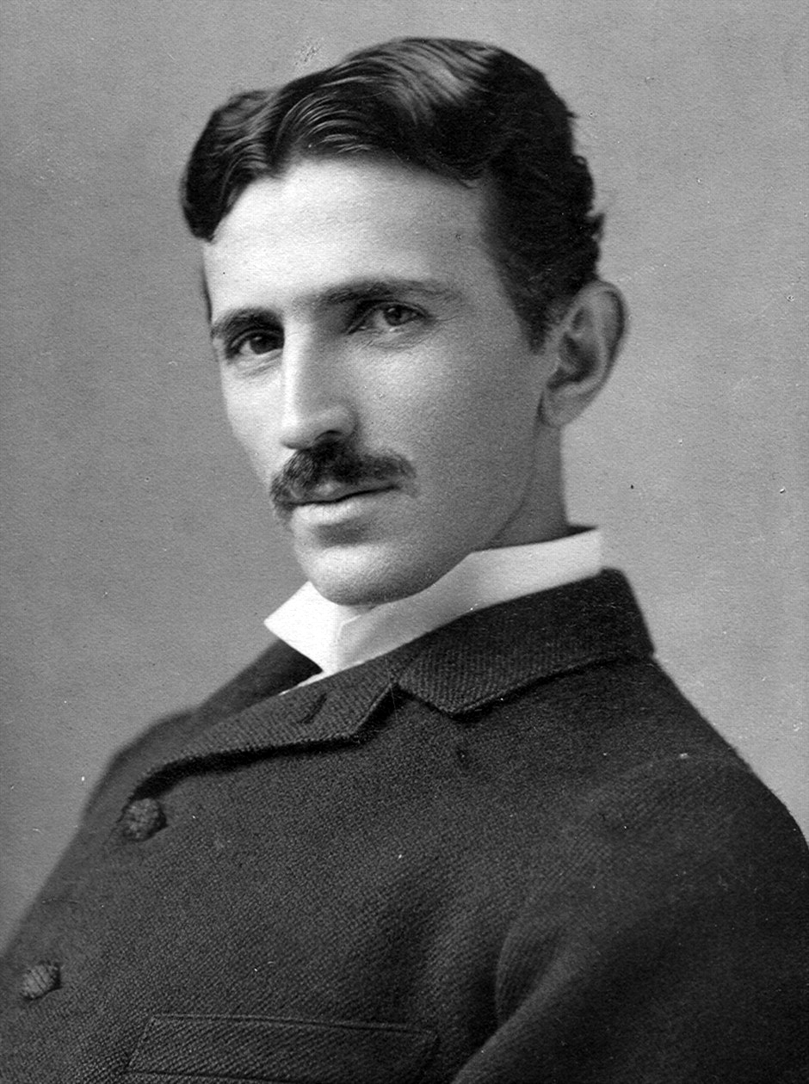
Nikola Tesla
(July 10, 1856 – January 7, 1943)
Nikola Tesla was a Serbian American inventor, electrical engineer, mechanical engineer, and futurist best known for his contributions to the design of the modern alternating current(AC) electricity supply system. His 1891 invention, the "Tesla coil," is still used in radio technology today. Around 1900 Tesla began working a global communication system. He wanted to provide free electricity to the world via a large electrical. The system failed due to financial constraints, and Tesla had no choice but to abandon the project (on his Long Island, New York laboratory) In 1917, the site was sold, and Tesla's tower was destroyed.

