Slide 1
Mathematics
Ancient Era
1650 – 1548
BCE - CE
Geometry
Industrial Era
1736 – 1856
APA
Modern Era
1860 – Present
Algebra I
Renaissance Era
1564 - 1731

Slide 2
Mathematics Biography Project – Grading Rubric
Written Report:
The written report must be 250 words long and presented via Google Docs. The paper will be double spaced and typed using font size 12. It should include the title, the author and the person chosen. It should be typed and in complete sentences. The sentences should have the correct capitalization and punctuation and the spelling should be correct. It should include information about the subject’s early life, family, accomplishments, interesting facts and, if appropriate, death. At least three sources are required and will be properly cited on a separate page. The report will submitted to the “classroom” on the date agreed upon
Oral Presentation:
The oral component of the project will be presented in class. The student will present information about the subject’s early life, family, accomplishments, interesting facts and, if appropriate, death. A Google Slides timeline, containing the same information about the person’s life, will also be required on the day of the presentation.
Grade Points
A 24 – 20
B 19 – 15
C 14 – 10
D 9 – 5
F 4 – 0

Slide 3
Category | 4 | 3 | 2 | 1 | Total Points
Organization | Information is very organized with well-constructed paragraphs | Information is organized with well-constructed paragraphs | Information is organized, but paragraph are not well-constructed | The information appears to be disorganized
Quality of Information | Information clearly relates to the main topic. It includes more than two supporting details and/or examples. | Information clearly relates to the main topic. It provides one-two supporting details and/or examples. | Information clearly relates to the main topic. No details and/or examples are given. | Information has little or nothing to do with the main topic
Mechanics | No grammatical, spelling or punctuation errors. | Almost no grammatical, spelling or punctuation errors. | A few grammatical spelling or punctuation errors. | Many grammatical, spelling or punctuation errors.
Biography | Biography is neat well explained and shows significant research into the topic | Biography is neat; explanations are given and show the beginnings of research into the topic. | Biography is neat, very brief and explanations show very little research into the topic | Biography is not neat and /or shows no research into the topic.
Oral Communication | Student spoke loudly, clearly and made eye contact with audience during presentation. Had excellent command of knowledge | Student spoke loudly, clearly and made eye contact with audience during presentation. Had a fair command of knowledge | Students presentation was brief, unclear, failed to make eye contact during presentation. Communicated very little knowledge audience. | Student’s presentation was distracted and was unable to communicate ideas to audience
Time Line | Timeline is neat well explained and shows significant research into the topic | Timeline is neat; explanations are given and show the beginnings of research into the topic | Timeline is neat, very brief and explanations show very little research into the topic | Timeline is not neat and /or shows no research into the topic

Slide 4
Ames (1650 BCE)
Ahmes was an ancient Egyptian scribe. He wrote the Rhind Mathematical Papyrus, a work of Ancient Egyptian mathematics that dates to approximately 1650 BC. he is the earliest contributor to mathematics whose name is known.

Slide 5
Baudhayana (800 BCE – 740 BCE)
Possibly the original founder of Pythagoras theorem is Baudhayana. Baudhayana was an ancient Indian mathematician who gave the geometrical proof of the Pythagoras theorem for a right triangle. He is also known for calculating the value of pi with some degree of precision. Baudhayana lived and worked centuries before the Pythagoras was even born has the earliest account of Pythagoras theorem. In addition Baudhayana not only proved the theorem but also gave a series of algebraic triplets commonly known as Pythagoras triplets.

Slide 6
Pythagoras (570 BCE - 495 BCE)
Pythagoras of Samos was Greek mathematician. He is considered by some to be one of the first great mathematicians. He founded the Pythagorean cults, who were the first group of people to actively study and advance mathematics. He is also credited with the Pythagorean Theorem. However, some sources say that it was Baudhayana, who lived some 300 years earlier in India. Nonetheless he can still be called one of the founding members of modern mathematics

Slide 7
Aristarchus of Samos (310 BCE - 230 BCE)
Aristarchus was an ancient Greek astronomer and mathematician who presented the first known model that placed the Sun or “central fire” at the center of the known universe with the Earth revolving around it. His astronomical ideas were often rejected in favor of the geocentric theories of Aristotle and Ptolemy.

Slide 8
Euclid (300 BCE - 275 BCE)
Living around 300BC, he is considered the Father of Geometry. His book, Elements, is one the greatest mathematical works in history. Unfortunately, little is known about his life, and what exists was written long after his presumed death. Euclid is credited with the use of logical proofs for theorems and conjectures. His ideas are still used today.

Slide 9
Archimedes (287 BC – 212 BC)
Archimedes was an ancient Greek mathematician, physicist, engineer, inventor, and astronomer. He was one of the greatest minds in antiquity. Archimedes had great demonstrations of the lever and designed many machines. Modern experiments have tested claims that Archimedes designed machines capable of lifting attacking ships out of the water and setting ships on fire using an array of mirrors. He also created the Archimedes screw, a type of water pump that is still in use today.
Archimedes died during the Siege of Syracuse when he was killed by a Roman soldier despite orders that he should not be harmed. At the top of his tomb was a formula that proved that a sphere has two thirds of the volume and surface area of a cylinder.

Slide 10
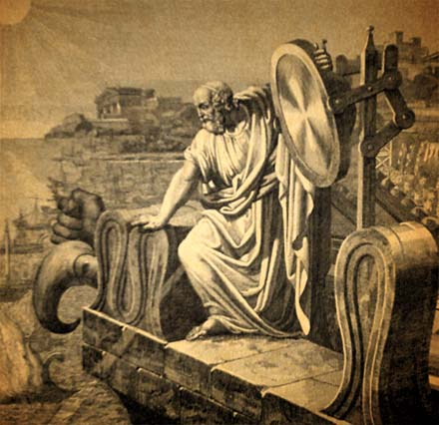
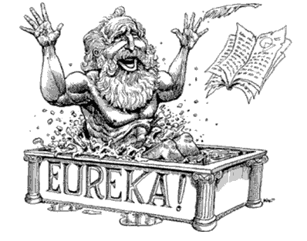
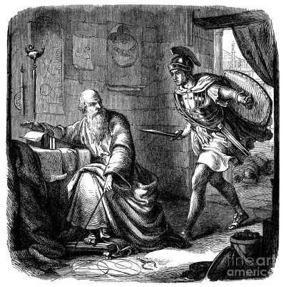
“Take that you dumb boat!”
“Give me a place to stand and a lever long enough and I will move the world.”
“Don’t disturb my circles…”

Slide 11
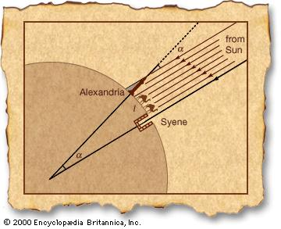
Eratosthenes of Cyrene (276 BCE – 195 BCE)
Eratosthenes was a Greek mathematician, geographer, poet, astronomer, and musician. He was the chief librarian at the Library of Alexandria and invented the discipline of geography.
He is best known for being the first person to calculate the circumference of the Earth with remarkable accuracy. He was also the first to calculate the tilt of the Earth's axis. Additionally, he accurately calculated the distance from the Earth to the Sun and invented the leap day. Eratosthenes created the first map of the world that used parallels and meridians.

Slide 12
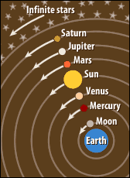
Ptolemy (90 BCE – 170 BCE)
Ptolemy was an Egyptian astronomer, mathematician, and geographer. He is most famous for his geocentric(Earth-centered) model of the universe now known as the Ptolemaic system.
His major astronomical work, the Almagest, contains reports of astronomical observations that Ptolemy had made over his lifetime.

Slide 13
Hypatia of Alexandria (370 – 405)
Greek, philosopher, astronomer, and mathematician. She was the head of the Neoplatonic School in Alexandria, Egypt. Hypatia taught students from all over the empire.

Slide 14
Brahmgaupta (597 – 668)
Brahmagupta was an Ancient Indian astronomer and mathematician. Although Brahmagupta thought of himself as an astronomer who did some mathematics, he is now mainly remembered for his contributions to mathematics. Brahmagupta was the first person in history to see zero as a number with its own properties. Many of his important discoveries were written as poetry rather than as mathematical equations.

Slide 15
Al Khwarizmi (780 – 850)
Abu Ja'far Muhammad ibn Musa al-Khwarizmi or the Father of Algebra lived in Baghdad, around 780 to 850 CE (or AD). He was one of the first to write about algebra. Around 825 he wrote the book "Hisab Al-jabr w’al-muqabala", from which we get the word “algebra” (meaning 'restoration of broken parts'). This book included many word problems, especially dealing with inheritance. Al-Khwarizmi helped establish widespread use of Hindu-Arabic numbers: 1, 2, 3…

Slide 16
Fibonacci (1170 – 1250)
One of the middle ages greatest mathematicians, he is best known for his Fibonacci Sequence. He also contributed greatly to the introduction of the Arabic numbering system to the western world. In 1202 he published Liber Abaci. In which he used Arabic numbers to solve problems that dealt with many real life situations.

Slide 17
Leonardo Da Vinci (April 15, 1452 – May 2, 1519)
Leonardo Da Vinci was an Italian Renaissance polymath: painter, sculptor, architect, musician, mathematician, engineer, inventor, anatomist, geologist, cartographer, botanist, and writer. He was constantly curious and had an amazing inventive imagination. He is considered to be one of the greatest painters of all time and perhaps the most diversely talented person ever to have lived.

Slide 18
Nicolaus Copernicus (February 19, 1473 - May 24, 1543)
Nicolaus Copernicus was born in Torun, Poland. When he was about 35 years old he developed his own celestial model of our solar system. Copernicus suggested that we are part of a heliocentric planetary system; in which the sun, rather than the earth, is the center of the solar system. Around 1514, he shared his findings in the Commentariolus. In his second book, De revolutionibus orbium coelestium, he offered more proof for his theory. Not many people were able to read it as it was banned by the Roman Catholic Church. On the Revolutions of the Celestial Spheres is considered a major event in the history of science. It began the Copernican Revolution and contributed greatly to the scientific revolution.

Slide 19
Viete (1540

Slide 20
Brahe (1546

Slide 21
Bruno (1548

