Slide 1
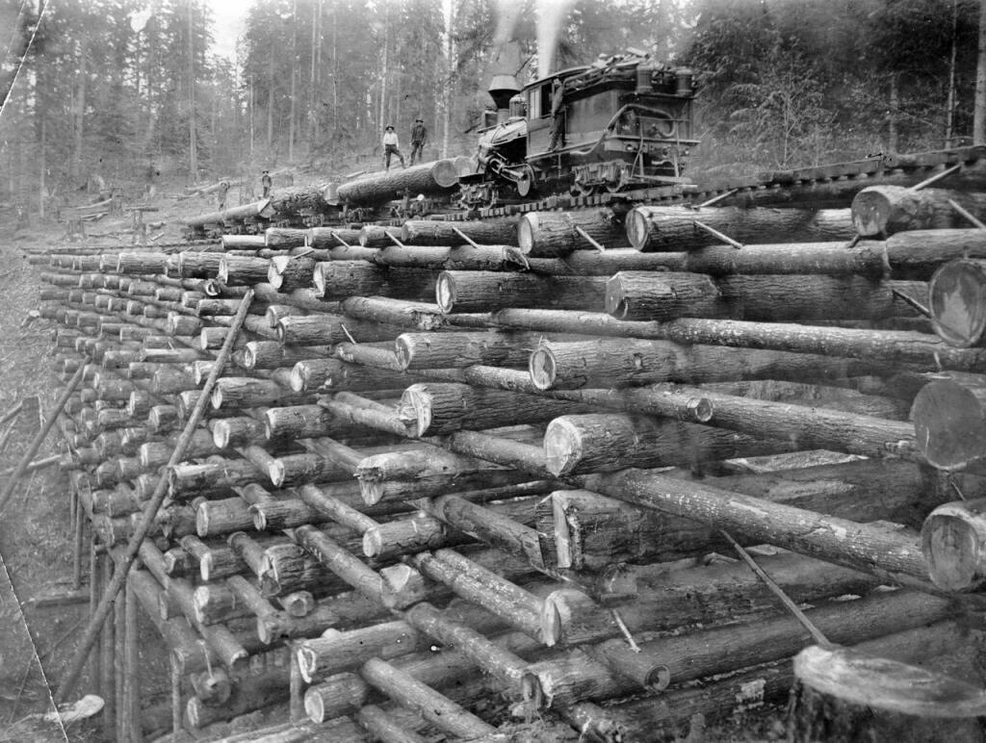
The Bridge Project
The Bridge Project

Slide 2
Six Bridge Types
Arc Beam
Cable-Stayed Cantilever Suspension Truss

Slide 3
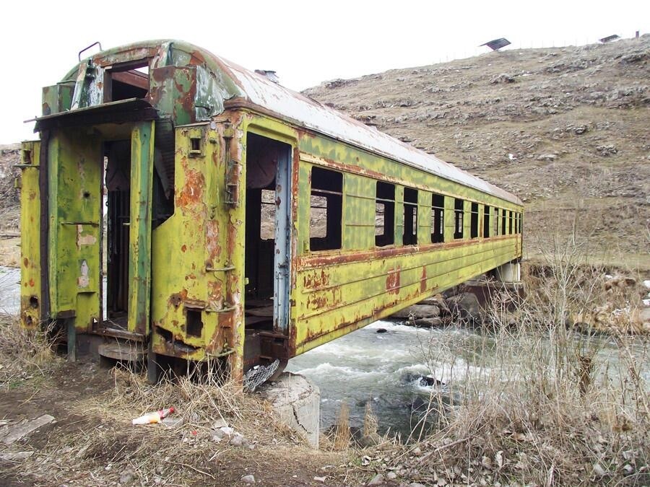
Beam Bridge

Slide 4
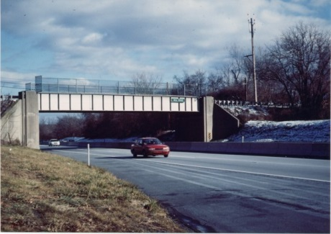
Beam Bridge – a simple type of bridge composed of horizontal beams supported by vertical supports

Slide 5
Despite the addition of a truss, the beam bridge is still limited in the distance it can span. As the distance increases, the size of the truss must also increase, until it reaches a point where the bridge's own weight is so large that the truss cannot support it.

Slide 6
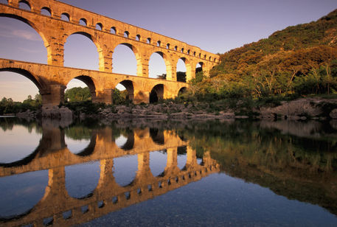
Arch Bridge

Slide 7
An arch bridge is a semicircular structure with abutments on each end. The design of the arch, the semicircle, naturally diverts the weight from the bridge deck to the abutments. Arch bridges are always under compression.

Slide 10
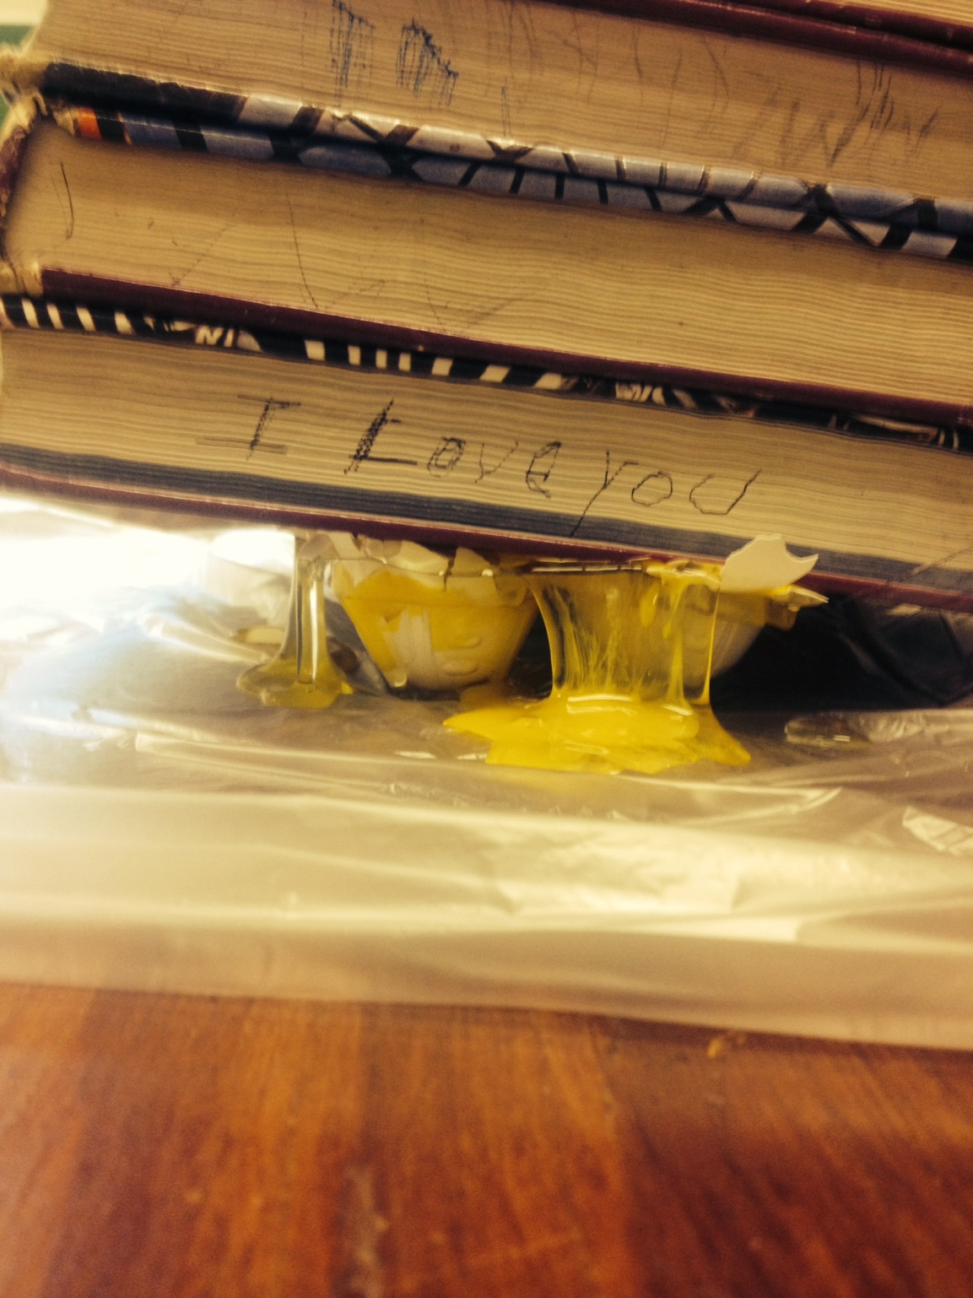
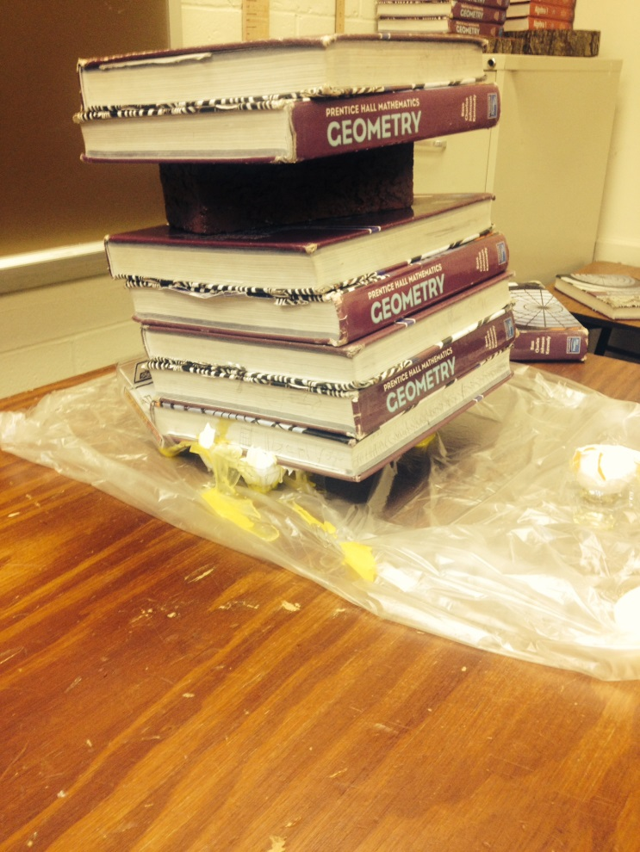

Slide 11
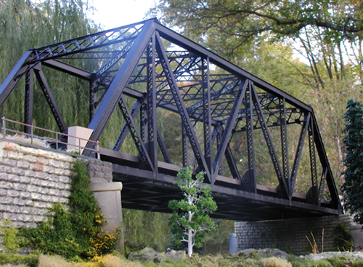
Truss Bridge

Slide 12
A truss bridge is a triangulated structure based on the idea that all loads can be carried by simple tension and compression members.

Slide 13
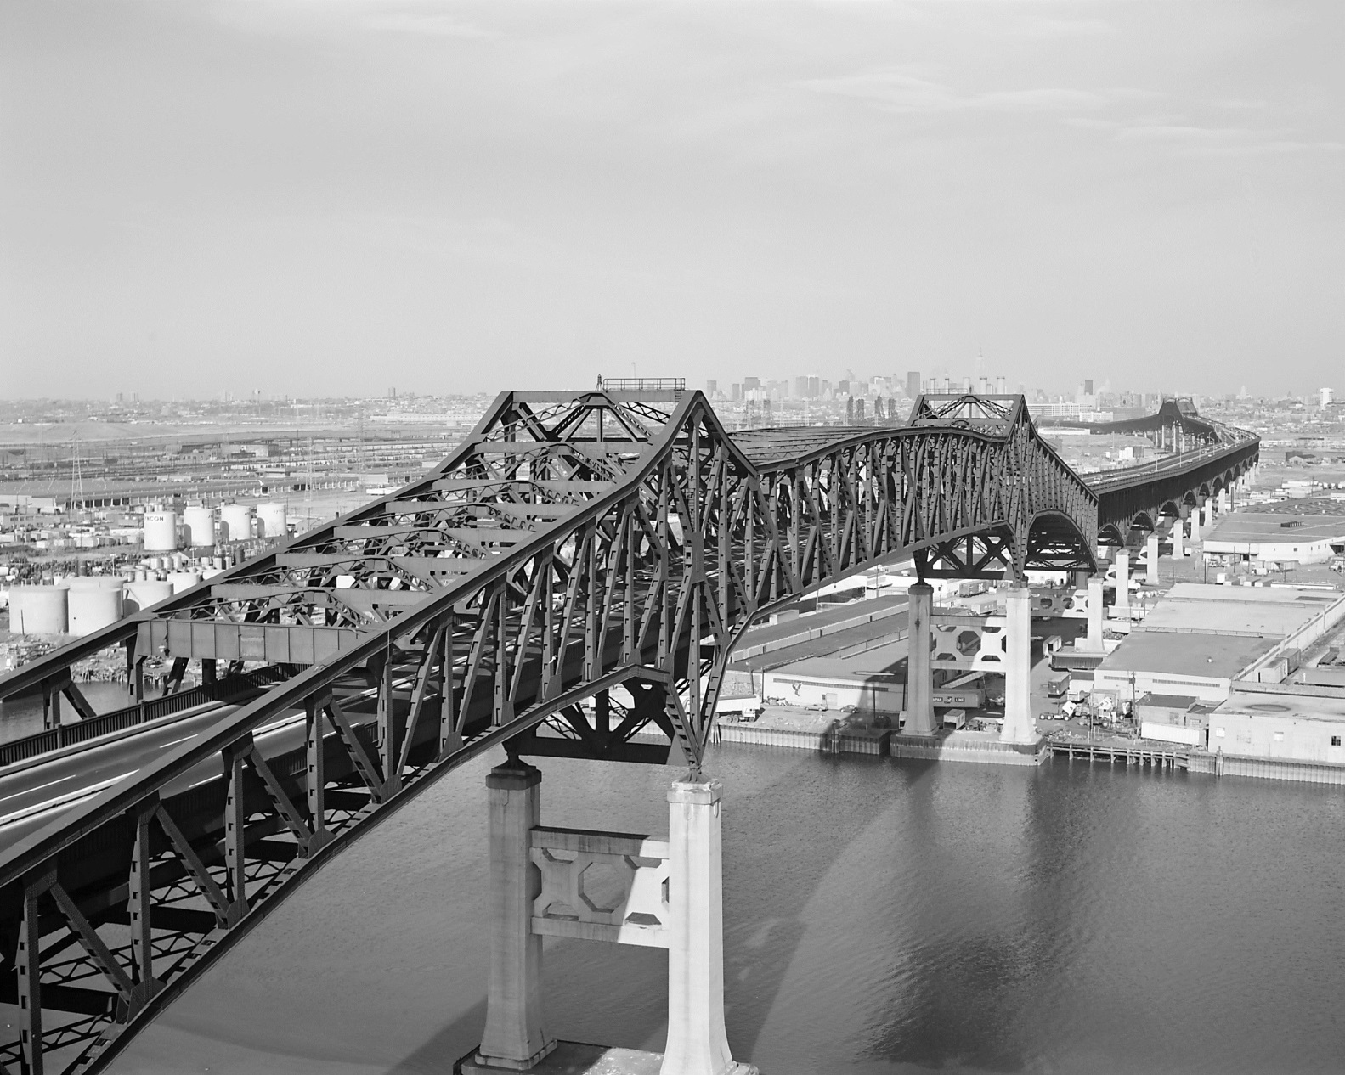
Cantilever Bridge

Slide 14
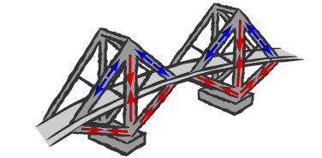
A cantilever bridge is a projecting structure supported only at one end, much like a shelf bracket or a diving board. A good example of this bridge type is the Pulaski Skyway in Kearney, NJ.

Slide 15
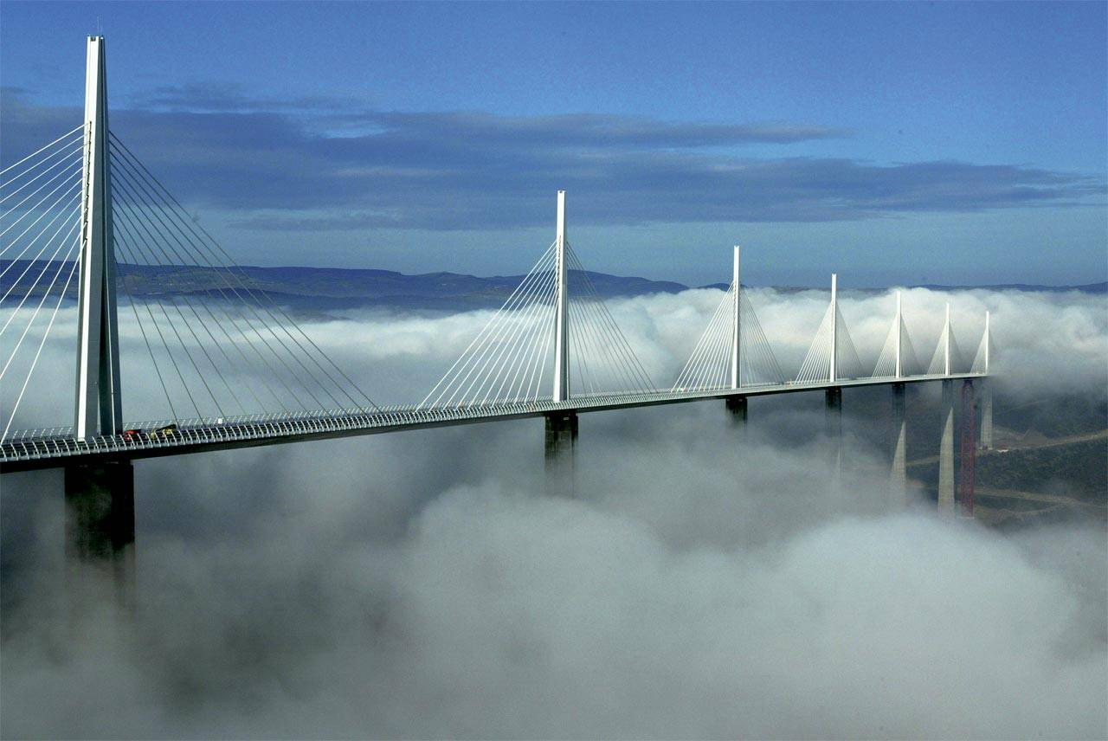
Cable-Stayed Bridge

Slide 16
A Cable-Stayed Bridge is a bridge in which the roadway deck is suspended from cables that are anchored to one or more towers.

Slide 17
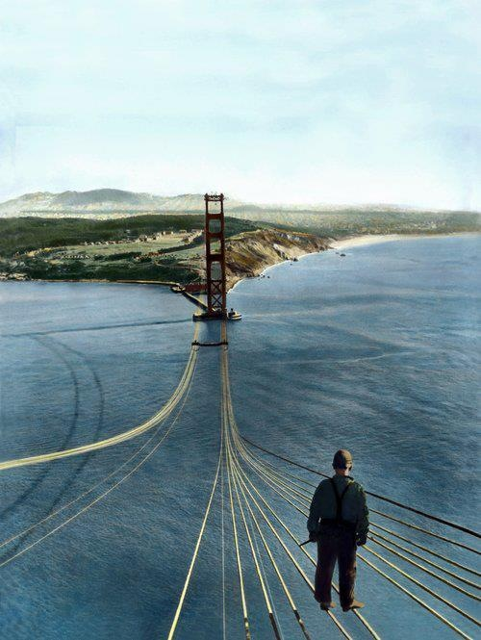
Suspension Bridge

Slide 18
A suspension bridge is one where cables are strung across the river and the deck is suspended from these cables. Modern suspension bridges have two tall towers through which the cables are strung. The towers support the majority of the roadway's weight.

Slide 19
Bridge Forces
Compression
Dissipation
Load
Resonance
Tension
Torsion

Slide 20
Compression - A force that tends to shorten or squeeze something, decreasing its volume. Compression causes things to get shorter and fatter. Load - A weight or mass that is supported. Tension - is the pulling force exerted by a string, cable, chain, or similar solid object on another object. Tension causes things to get longer and thinner. Torsion is a rotational or twisting force. Because suspension bridges are hanging from a pair of cables they are more susceptible to torsion, especially in high winds. As a result all suspension bridges have deck-stiffening trusses which eliminate the effects of torsion.
These forces are not as obvious in ridged materials because the shortening, lengthening and twisting is very small.

Slide 21
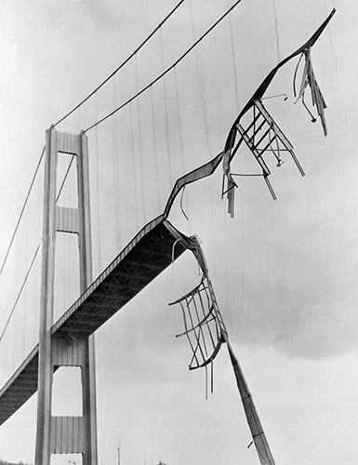
Resonance is a vibration caused by an external force that is in harmony with the natural vibration or the original thing. It can be fatal to bridges because resonant vibrations can travel through a bridge in the form of waves. A famous example of resonance waves destroying a bridge is the Tacoma Narrows Bridge, which fell apart in 1940 in a 40-mph wind.

Slide 22
The wind that day was at just the right speed and hitting the bridge at just the right angle, to start it vibrating. Continued winds increased the vibrations until the waves grew so large and violent that they broke the bridge apart.

Slide 23
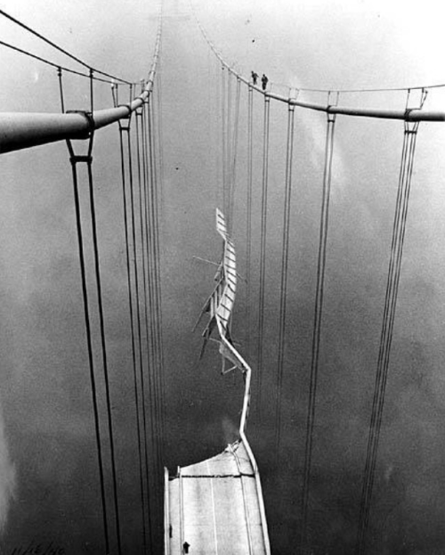
Leonard Coatsworth, was on the bridge when during the collapse. below is his account:
“Just as I drove past the towers, the bridge began to way violently form side to side. Before I realized it , the tilt became so violent that I lost control of the car…I jammed on the brakes and got out, only to be thrown onto my face against the curb…Around me I could hear concrete cracking…the car itself began to slide from side to side of the roadway. On my hands and knees most of the time, I crawled 500 yards or more to the towers…My breath was coming in gasps; my knees were raw and bleeding, my hands bruised and swollen form gripping the concrete curb…Toward the last, I risked rising to my feet and running a few yards at a time…Safely back at the toll plaza, I saw the bridge in its final collapse and saw my car plunge into the Narrows.”
No human life was lost in the collapse of the bridge, though Coatsworth’s cocker spaniel named “Tubby” was lost along with his car in the collapse.

Slide 24
When an army marches across a bridge, the soldiers are often told to “break step.” This is to avoid the possibility that their rhythmic marching will start resonating throughout the bridge. An army that is large enough and marching at the right cadence could start a bridge swaying and undulating until it broke apart.

Slide 25
To make bridges stronger, methods to spread out or dissipate the forces of tension and compression had to be addressed. If the load is too heavy, the forces of compression and tension will become too great and an ordinary beam bridge will eventually collapse. The addition of a truss is the answer to this problem. A truss or a triangular lattice work adds rigidity to the existing beam, greatly increasing its ability to dissipate compression and tension. Ones the beam begins to compress, the force is dissipated though the truss. In order for a truss to be effective it must be symmetrical or balanced in size and shape. If it is asymmetrical, then the bridge will fail and collapse.
Dissipation

Slide 26
The freezing wind strikes the bridge above and below and on both sides, so it’s loosing heat from all sides. The road is only losing heat from its surface. Even while the temperature on the road surface is dropping, the heat underneath the road keeps it warm enough to prevent icing as temperatures in the atmospheres hit the freezing point. Bridges are built with steel and concrete, both of which are good heat conductors. These materials conduct heat, any heat that the bridge has moves through the bridge to the surface where the heat is lost through the air flow around it. Roads are mostly made from asphalt, which is a poor conductor of heat and that lessens the rate of heat loss from the road. A bridge will follow the air temperature closely. If the air temperature falls below freezing, a bridges surface will fall below freezing quickly. Rain or snow, therefore, will freeze and stick to the bridge.
On a cold, rainy day, ice forms more quickly on bridges and overpasses for two reasons.

Slide 27
Steel is an excellent elastic material, for it can withstand large forces and then return to its original size and shape. Vertical girders of steel used in the construction of tall buildings undergo only slight compression. A typical 25-meter-long vertical girder (column) used in high-rise construction is compressed about a millimeter when it carries a 10-ton load. More deformation occurs when girders are used horizontally, where the tendency is to sag under heavy loads.
1932 – Construction workers take a lunch break on a steel beam atop the RCA Building at Rockefeller Center

Slide 28
The horizontal beam or simple beam shown below is supported at both ends, and carries a load in the middle. There is compression in the top of the beam and tension in the bottom part. There is a neutral layer along the middle portion of the thickness of the beam all along its length. This is a spot where there is neither tension nor compression

Slide 29
The cross-section of steel girders forms the letter I. Most of the material in the I-beams is concentrated in the top and bottom flanges; the piece joining the flanges, called the web, is much less wide. The flanges carry virtually all stresses in the beam. An I-beam is nearly as strong as a solid rectangular bar of the same overall dimensions, and its weight is considerably less. A large rectangular steel beam on a certain span would collapse under its own weight, whereas an I-beam of the same length could carry its own weight and more.

Slide 30
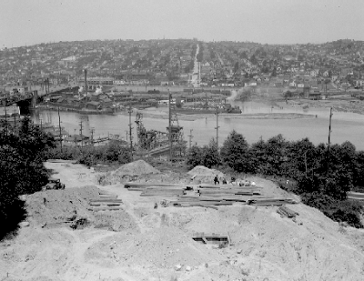
Future site of the George Washington Bridge around the year 1928.

Slide 31
Setting the footings that the towers would eventually sit on.

Slide 32
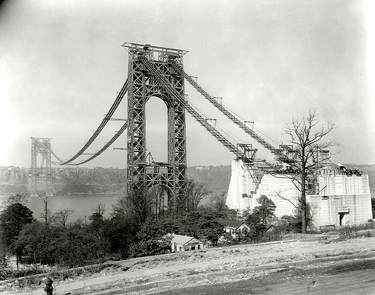

Slide 33
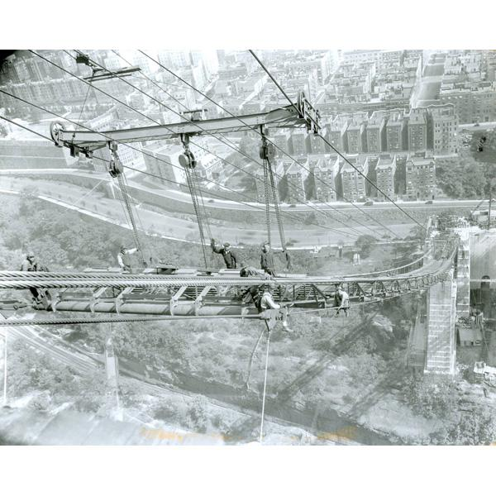

Slide 34
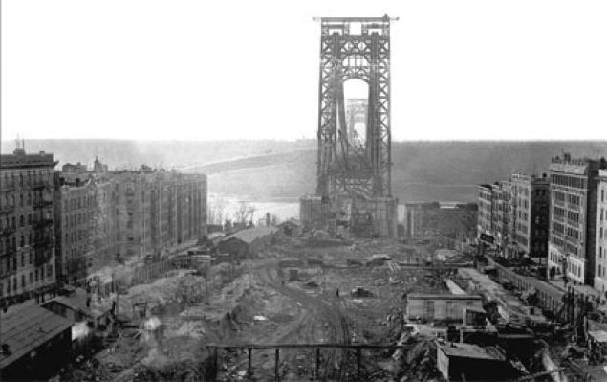

Slide 35
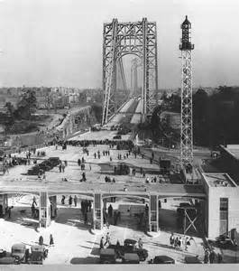
Completed October 25, 1931
Fort Lee Toll Plaza

Slide 36
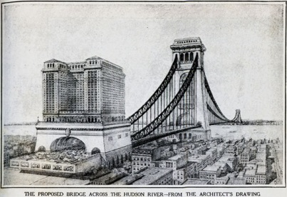

Slide 37
GWB Statistics Upper Level: October 25, 1931 Lower Level: August 29, 1962 Length of Bridge: 4,760 feet Width of bridge: 119 feet Width of roadway: 90 feet Height of tower above water: 604 feet Water clearance at mid-span: 212 feet

Slide 38
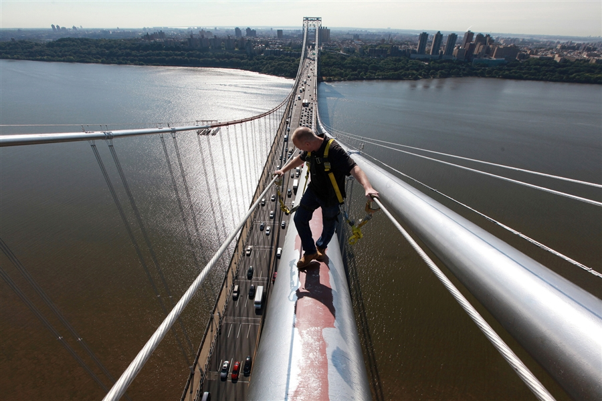
Maintaining the George Washington Bridge

Slide 39
Our Bridges

Slide 40
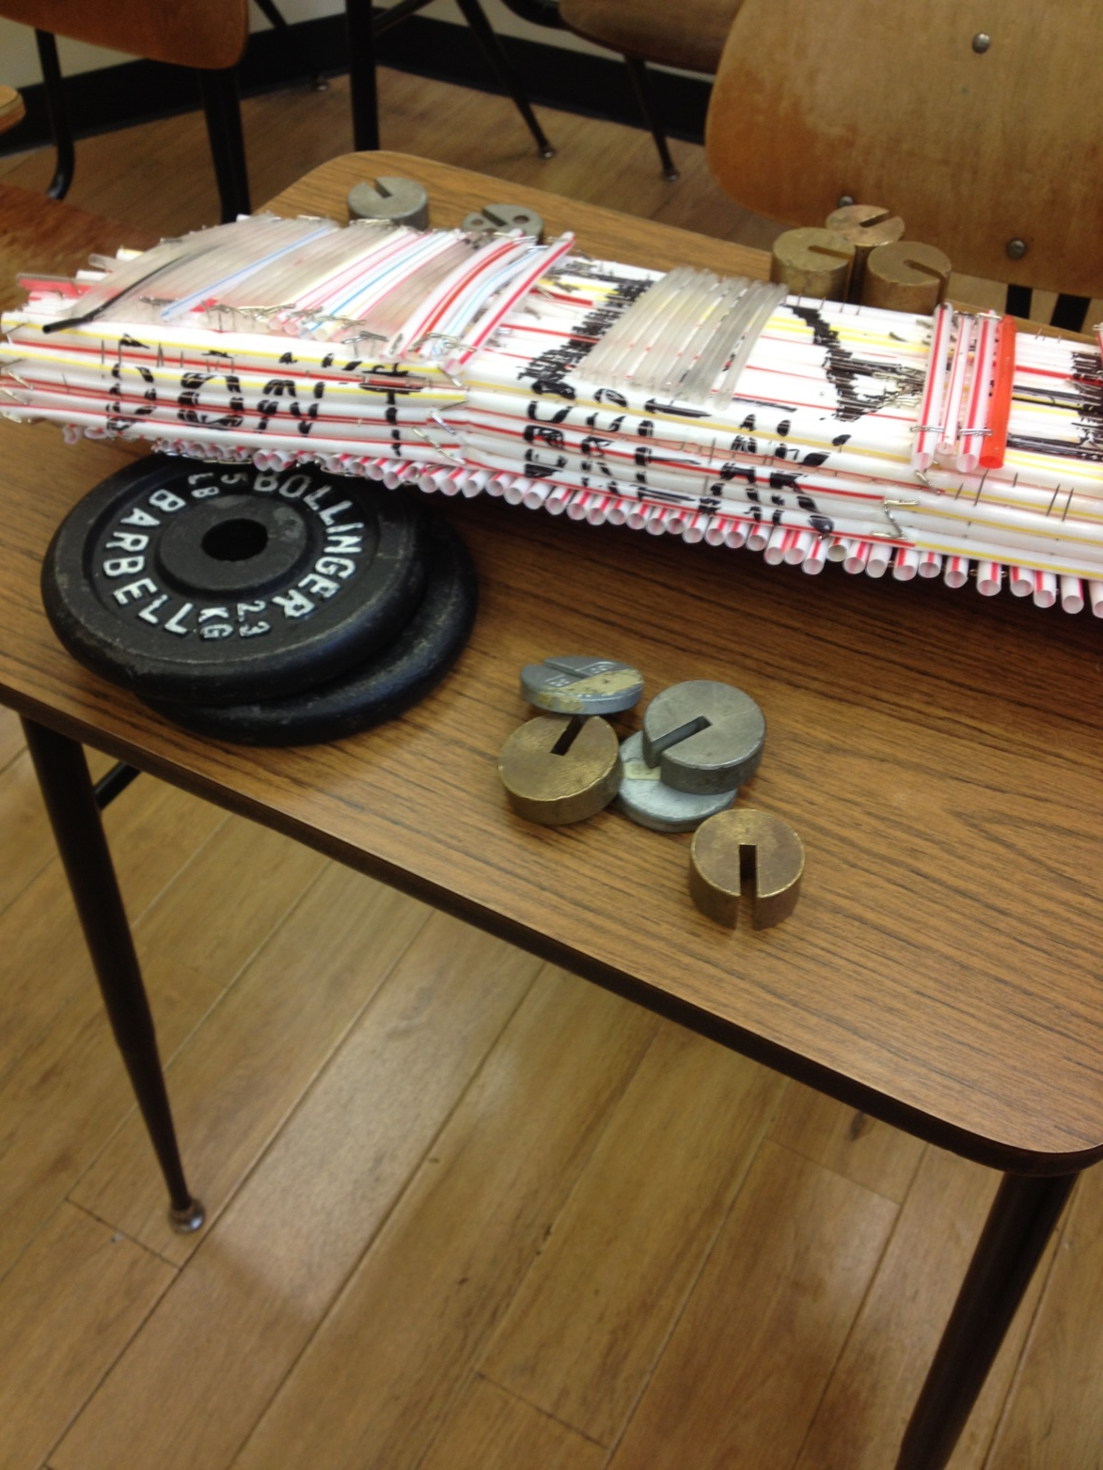
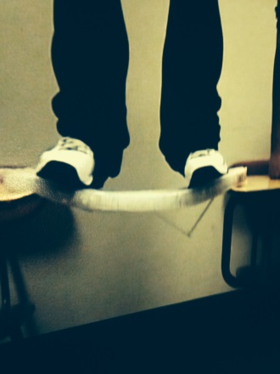
Our Bridges

Slide 41
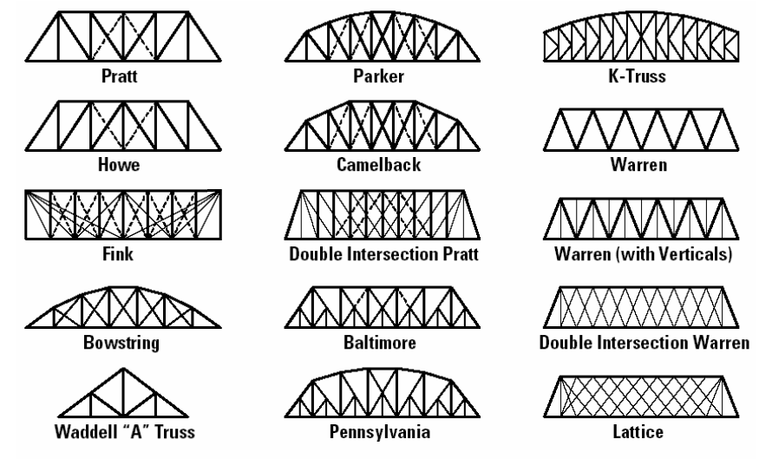
Possible Bridge Designs

Slide 42
Simple Truss
Simple Beam

Slide 43
Inverse Truss
Complex Triangles

Slide 44
Straw Mad-Genius

Slide 45
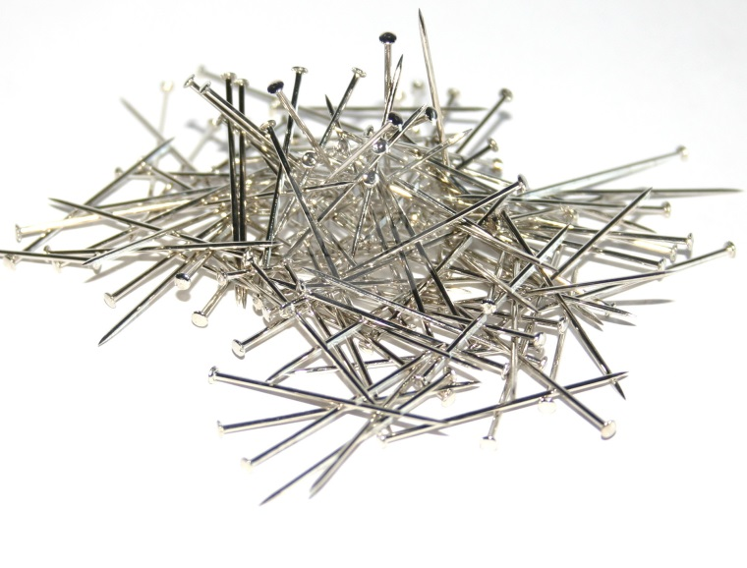
Materials

Slide 46
The objective is to build a strong but light bridge; using only pins and straws. Students will use the skills learned in class to construct a bridge that is well balanced, proportional and symmetrical. A bridge score will be achieved by dividing the weight held (load) by the weight of the bridge.
$\frac{weight held}{weight of bridge}=score$
Edgar’s Bridge held 120lbs in 2010

Slide 47
Your bridge will be made out of only pins and straws. No glue, tape or other adhesives may be used. You will need approximately 200 straws and two boxes of pins. The bridge must measure 8” wide and 21” long. Once built the bridge will be positioned at least one foot above the floor. We will then begin to add weight to the bridge. The bridge must bear the load for one minute to count. In addition to meeting the weight bearing and structural requirements, the bridge will also be judged on its aesthetics, so be creative.
A = 17-20
B = 13-16
C = 9-12
D = 5-8
F = 1-4

Slide 48
Bridge Building Rubric
Category | 1 | 2 | 3 | 4
Plan | Plan is not drawn to scale. Materials are not identified. | Plan has some materials labeled. Some Parts are drawn to scale. | Most materials are labeled. Most of the bridge is drawn to scale. | Outstanding design. Covered all requirements. Design is labeled drawn to scale and proper building material is used.
Bridge Knowledge | Explanations do not illustrate much understanding of scientific principles underlying the construction and modifications. | Explanations indicate relatively accurate understanding of scientific principles underlying the construction and modifications. | Explanations indicate a relatively accurate understanding of scientific principles underlying the construction and modifications. | Explanations indicate a clear and accurate understanding of scientific principles underlying the construction and modifications.
Completed Bridge | Bridge scores between 05. and 42.5. Bridge is not constructed to scaled plan. | Bridge scores between 43 and 84.5. Bridge is somewhat constructed to plan. | Bridge scores between 85 and 127. Bridge is similarly constructed to scaled plan. | Bridge scores between 128 and 170. Bridge is constructed to scale and is aesthetically pleasing.
Teamwork | All tasks were not completed. Two or more students did not follow assigned tasks. Tension within the group. | Some tasks were completed. Some ideas were incorporated into design and construction. | Most members completed their tasks. Most ideas were incorporated into design and construction. | All members completed their tasks. They listened to each other’s ideas and incorporated them into design and construction.
Aesthetic Quality | The project has none of the following aesthetic elements: proportion, symmetry and balance | The project has one of the following aesthetic elements: proportion, symmetry and balance | The project has two of the following aesthetic elements: proportion, symmetry and balance | The project has all three of the following aesthetic elements: proportion, symmetry and balance.

Slide 49
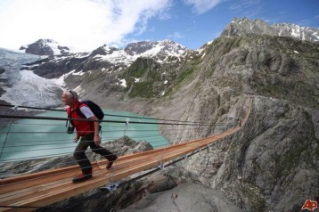
Notebook Test
What are the six bridge types?
What is the definition of a beam bridge?
Arch bridges are always under _____________.
The most important stone in an arch bridge is the _______________.
In a truss bridge, all loads are carried by ______________ and ______________.
The Pulaski Skyway is an example of what kind of bridge?
What is the job of the cables in a Cable-Stayed bridge?
The George Washington and Golden Gate are examples of what kind of bridge?
What are the six bridge forces?
What is the definition of load?
What force caused the Tacoma Narrows Bridge to collapse in 1940?
Why were soldiers ordered to “break step” when crossing bridges during the civil war?
How does a truss make bridges stronger.
Why will a bridge freeze before a road surface?
Where is the neutral layer on an I-beam?
When was the George Washington Bridge completed?
When was the lower level completed on the George Washington Bridge?
In a small village there was a troll who lived under a bridge. The only way in or out of the small hamlet was to take the bridge. It takes one minute to cross the bridge, even if you run. The troll sleeps for 30 seconds at a time under the bridge. When you get half way across the bridge, (which would take you 30 seconds), the troll wakes up and pushes you back to where you started. Everyone in the village has figured out how to get across the bridge, can you?

