Slide 1
Egg Drop Project
How to Drop An Egg Without Breaking It

Slide 2
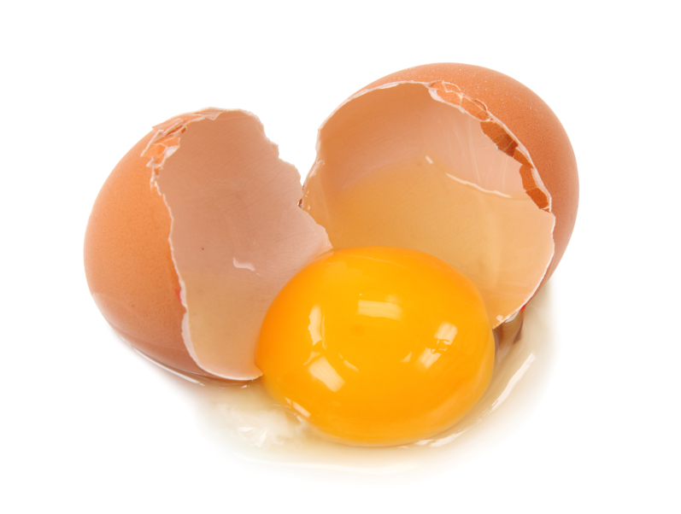
The Question
Can you design a container that will prevent the egg from breaking or cracking after a 20 foot free fall?

Slide 3
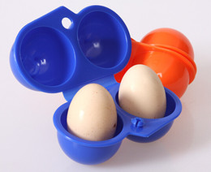
the Objective
The aim of this project is to design a protective egg vehicle (PEV) that will prevent an egg from breaking when dropped from a certain height. This project must adhere to the design parameters presented in class.

Slide 4
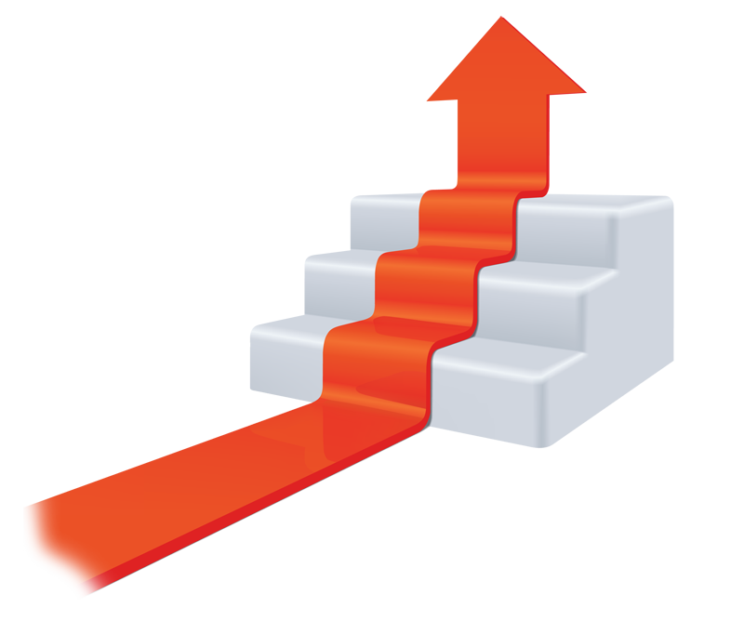
The Goals
Students will design and construct a protective egg device. Students will be able to explore the different materials available and learn to apply concepts of momentum, force and energy to this project.

Slide 5
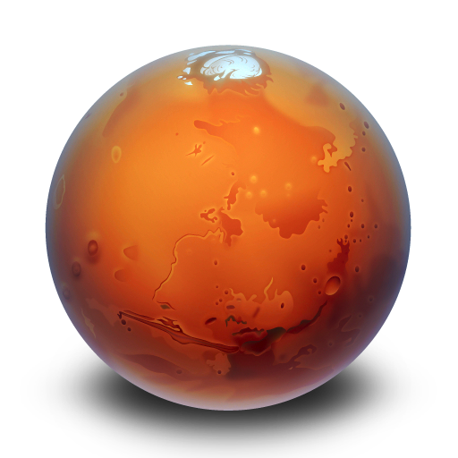
Why
Scientists and engineers are always working on ways to reduce the effect of impacts. For example, NASA has several designs to reduce impacts when sending probes to Mars.

Slide 6
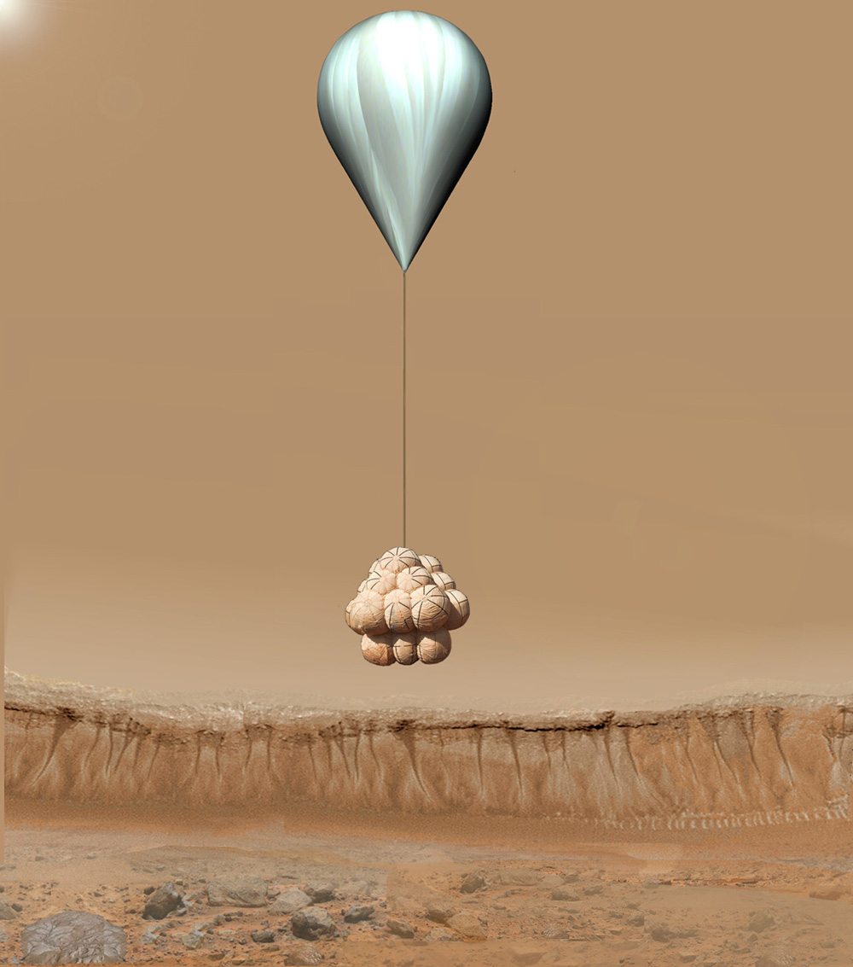
Mars Rover Spirit Balloon Landing

Slide 7
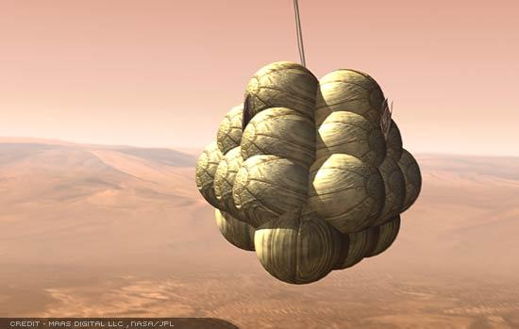

Slide 8
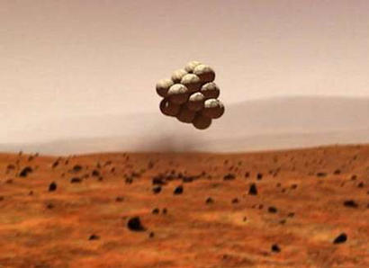

Slide 9
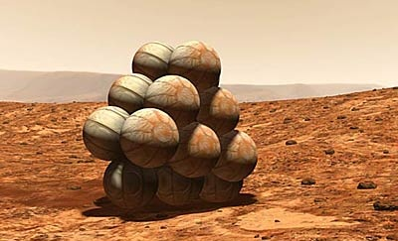

Slide 10
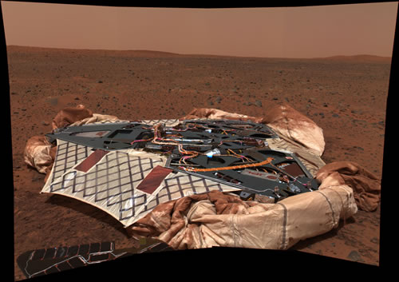

Slide 11
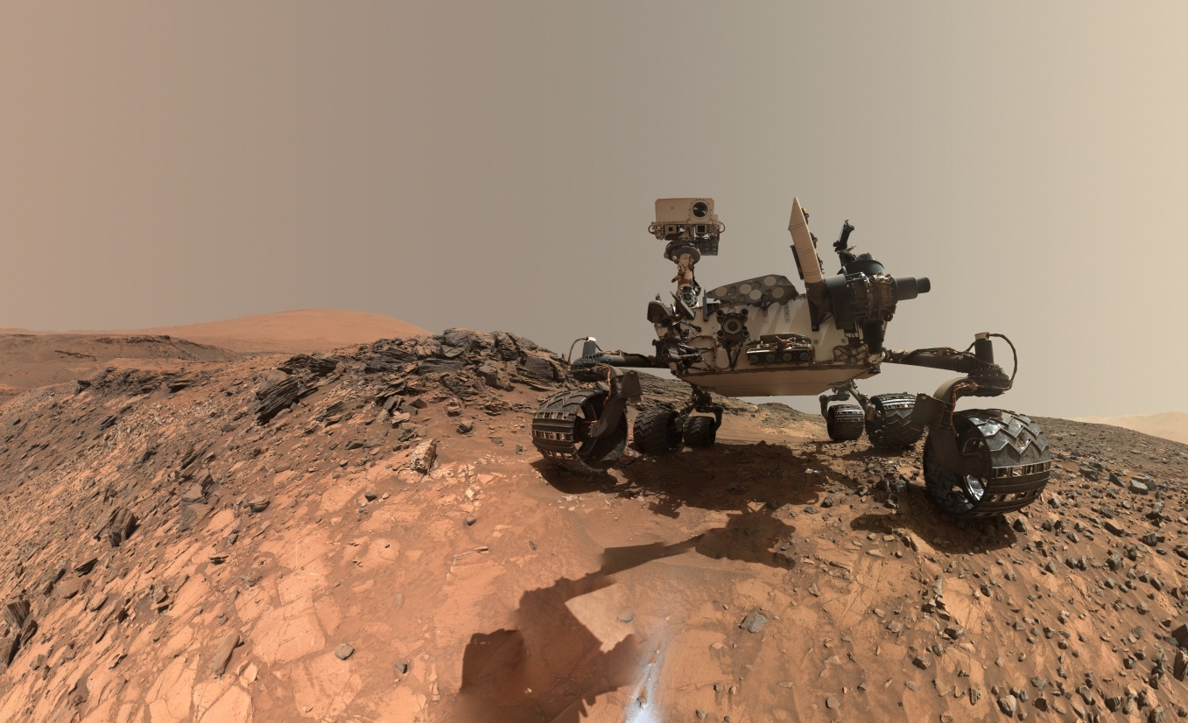

Slide 12
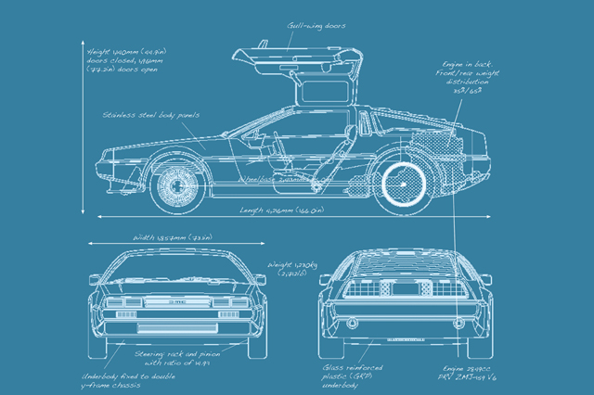
Why
In the automobile industry, scientists and engineers continue to find innovative ways to absorb energy and reduce impact forces.

Slide 13
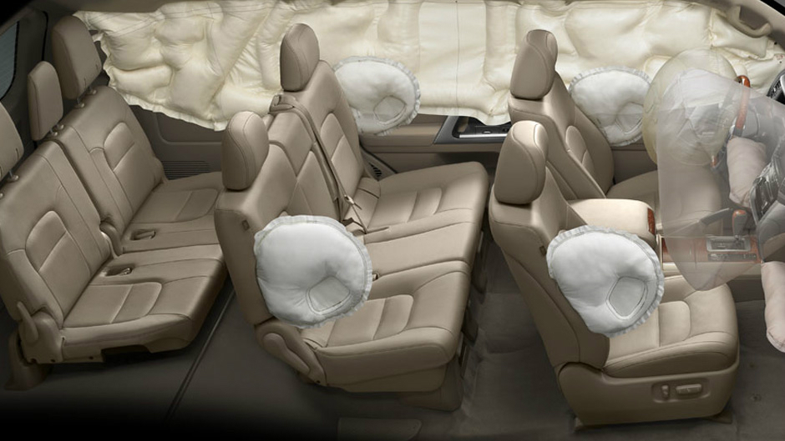

Slide 14
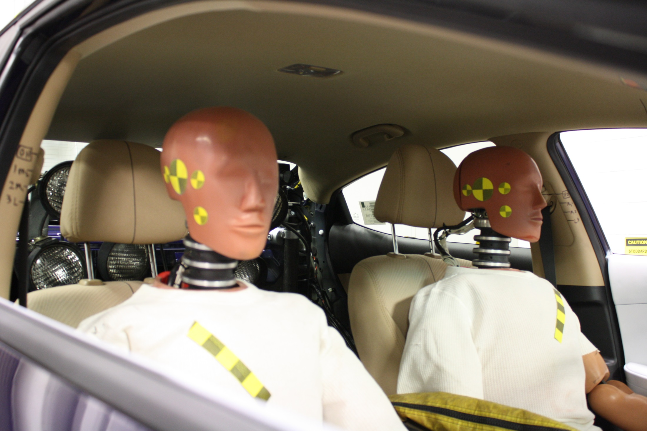

Slide 15
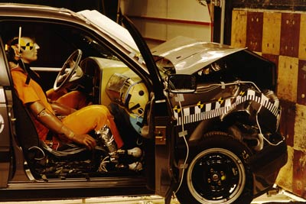
Crumple Zones

Slide 16
The Forces at Work
Five Concepts for Developing a Successful PEV

Slide 17
Momentum
Momentum is a measure of an object’s tendency to move at constant speed along a straight path. Momentum depends on speed and mass.
To calculate the momentum of a moving object multiply the mass of the object times its velocity.
momentum velocity
$$\overset{⃑}{p}=m\overset{⃑}{v}$$
mass

Slide 18
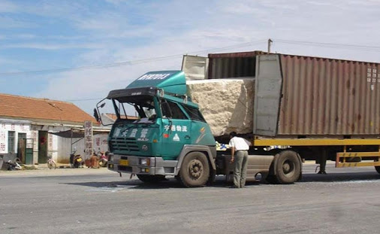

Slide 19
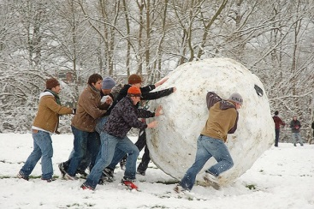

Slide 20
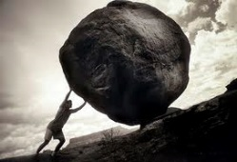
You just don’t want to end up like Sisyphus who, like so many others in Greek mythology, upset Zeus. Sisyphus was punished by being forced to roll an immense boulder up a hill, only to watch it roll back down, repeating this action for eternity.

Slide 21
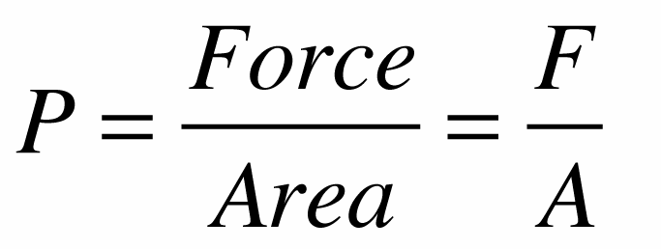
Pressure
Pressure is the force per unit area applied to an object in a direction perpendicular to the surface.
Pressure is calculated by taking the total force and dividing it by the area over which the force acts.
A very small pressure, if applied to a large area, can produce a large total force.

Slide 22
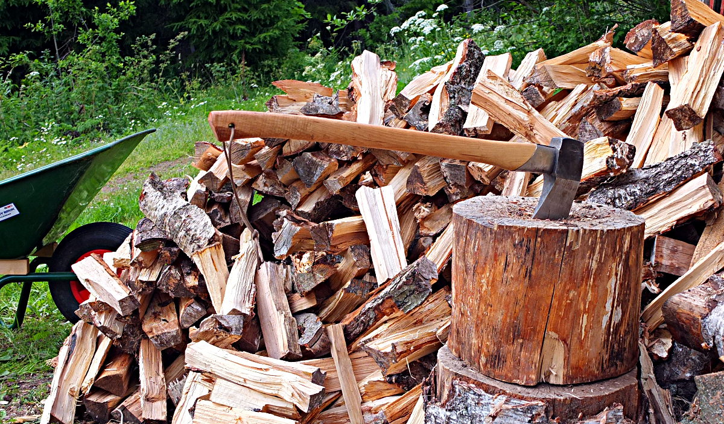
The front end of a wedge has a small contact area; the resulting pressure is large enough to push wood fibers apart.

Slide 24
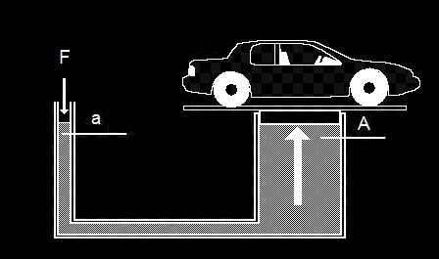
English: Pressure is exerted on fluid in small cylinder, usually by a compressor. Though the pressure is the same, it is exerted over much larger area, giving a multiplication of force that lifts the car.

Slide 25
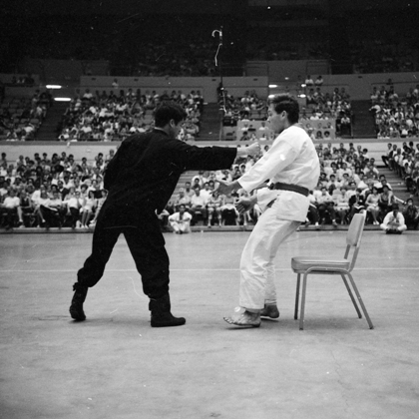
The recipient of Bruce Lee's one-inch punch was literally lifted off the ground.

Slide 26
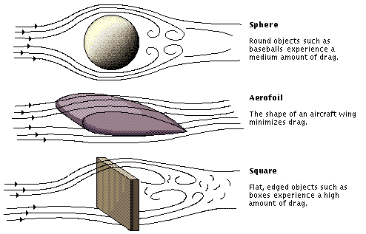
Air Resistance
Air resistance, also called drag, is when air molecules cause a frictional force that opposes the motion objects in motion.

Slide 27
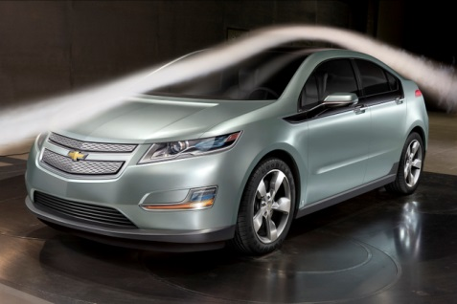

Slide 28
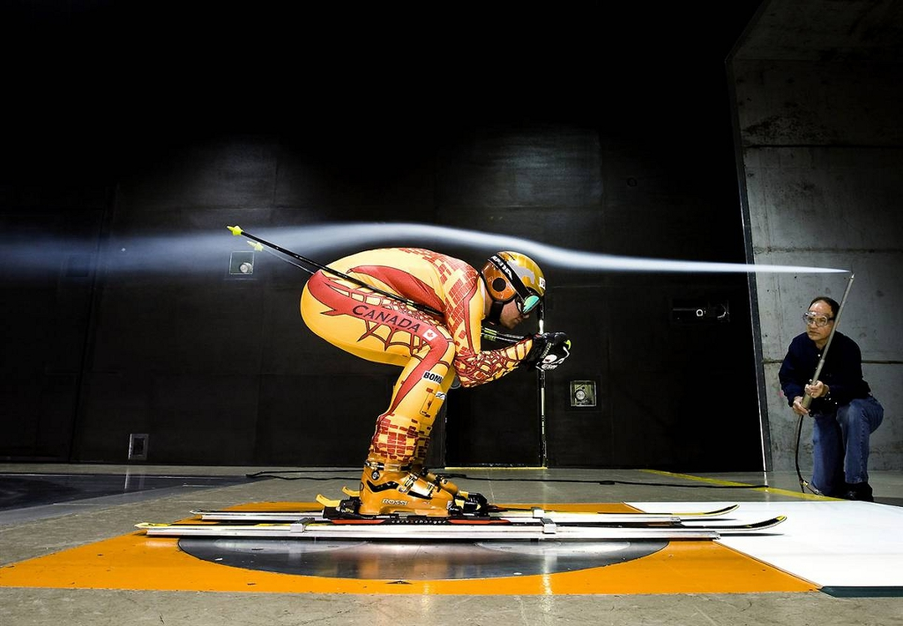

Slide 29
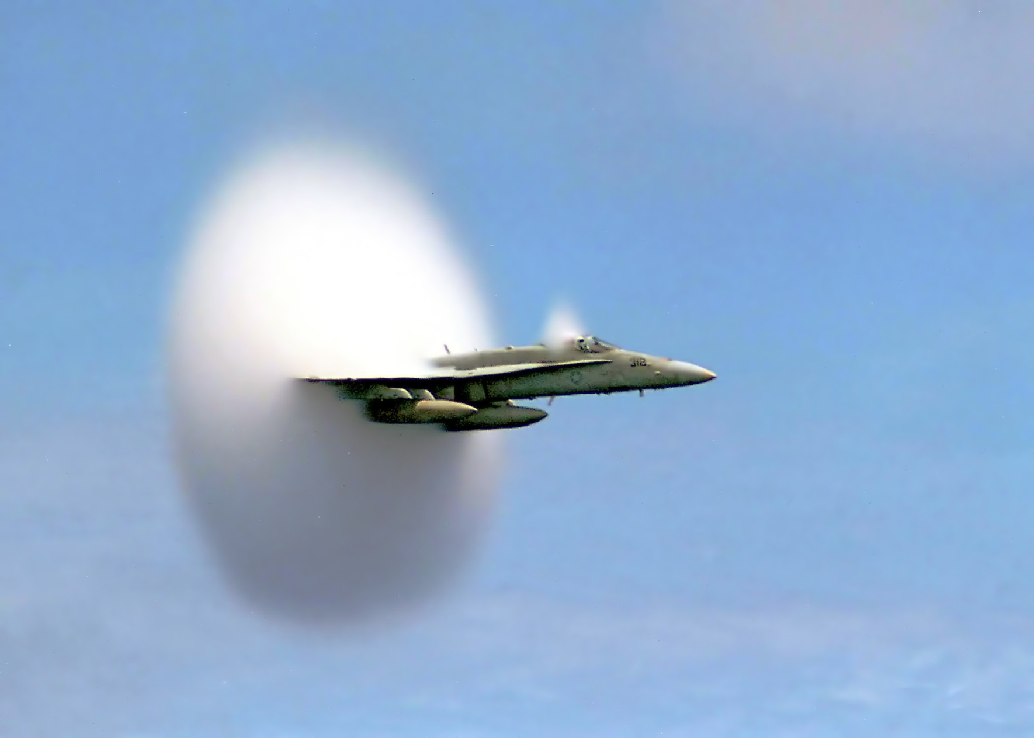

Slide 30
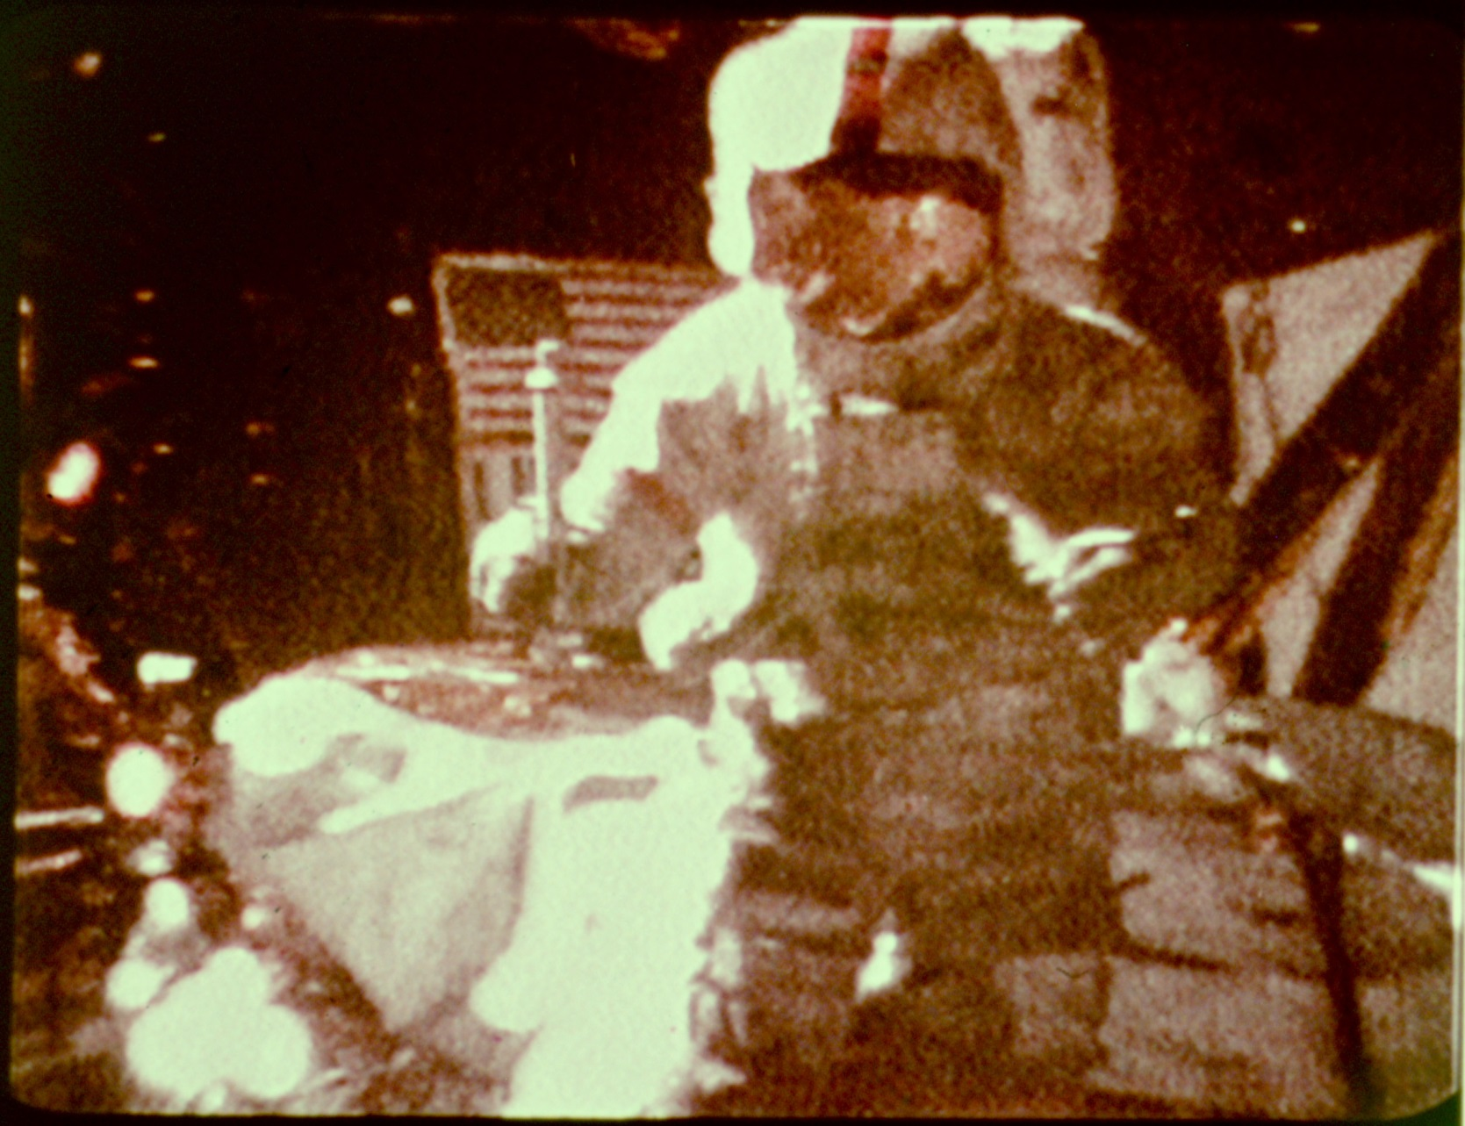
[PDF] Apollo 15 Hammer-Feather Drop
Apollo 15 Hammer-Feather Drop

Slide 31
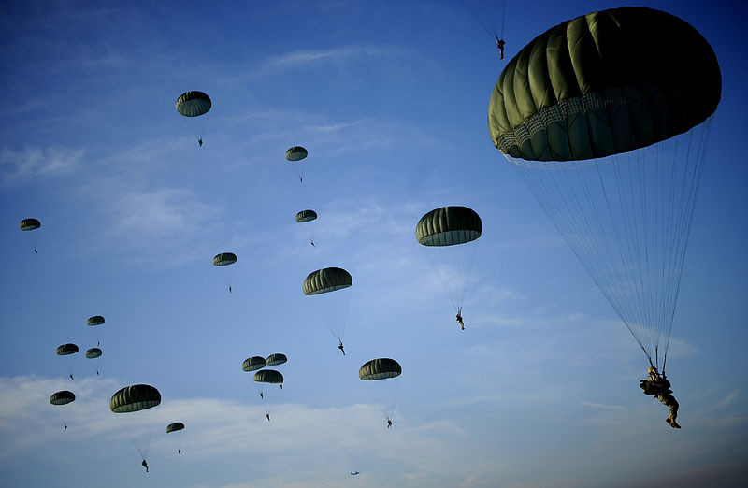

Slide 32
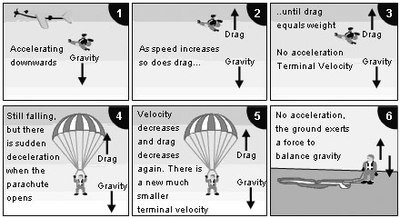

Slide 33
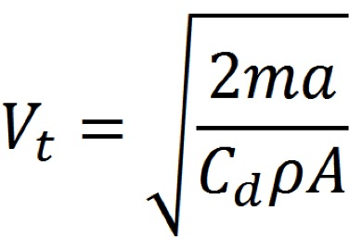
Terminal Velocity
An object in free fall in a vacuum will accelerate at approximately 9.8 m/s², independent of its mass.
With air resistance acting on an object that has been dropped, the object will eventually reach a terminal velocity

Slide 34
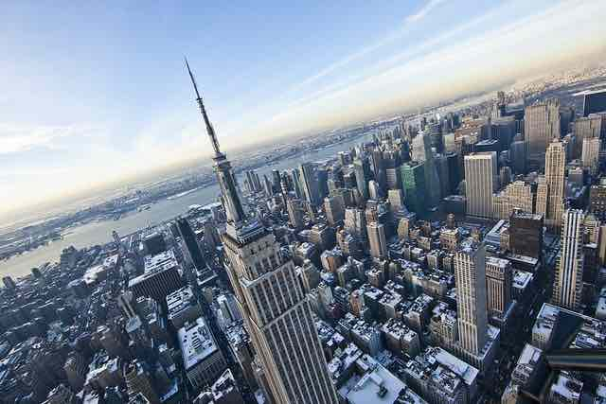
A penny's terminal velocity is going to be around 30-50 miles per hour. However, if there is a good breeze, that's going to drop significantly. A penny will reach its terminal velocity in only about 50 feet. So it won’t kill you but it definitely will hurt.

Slide 35
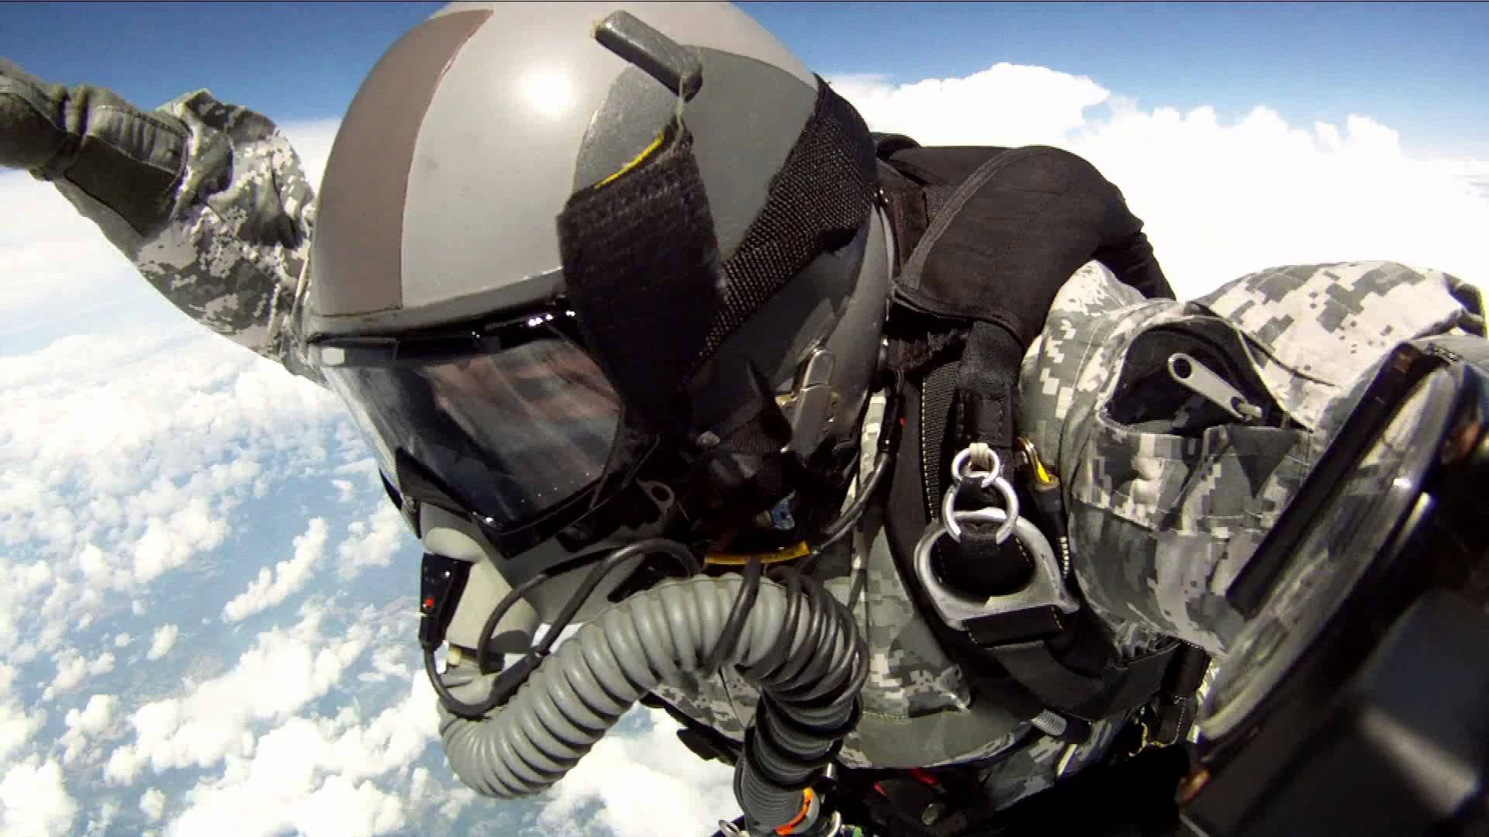
Terminal velocity of a human skydiver is around 53 m/s or 120 mph.

Slide 36
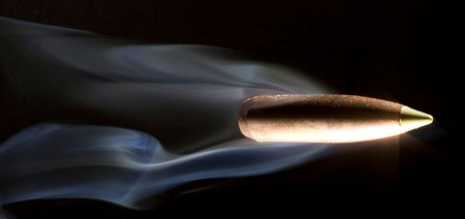
The terminal velocity of a bullet is approximately 90 m/s (300 feet per second or 204 miles per hour) depending on the caliber . A bullet traveling at only 61 m/s (200 feet per second or 136 mph) to can penetrate human skin.

Slide 37
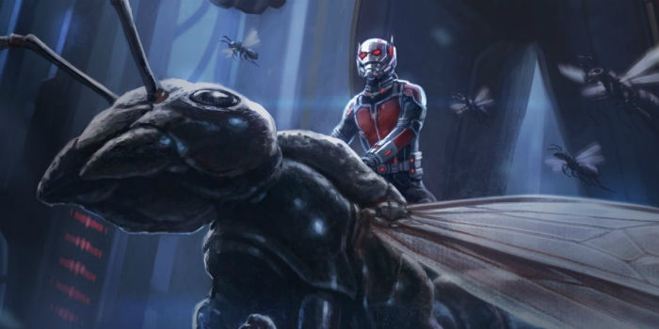
According to the physics department of the University of Illinois. The terminal velocity of a small to medium ant is about 6.4 km/h or 3.9 mph.

Slide 38
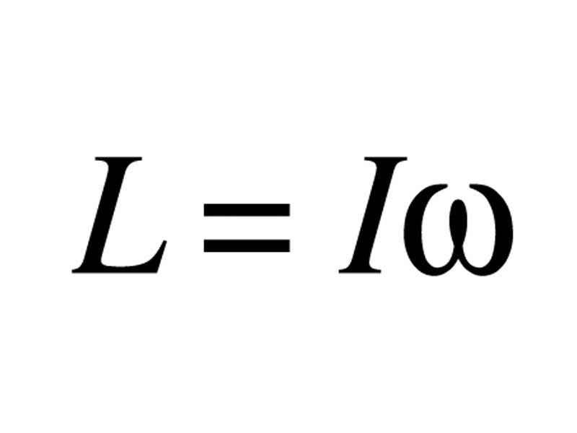
Angular Momentum
Angular momentum measures an object’s tendency to continue to spin. It can be obtained by multiplying the mass of an orbiting body by its velocity and the radius of its orbit.
Angular Momentum Angular Velocity
Moment of Inertia

Slide 39
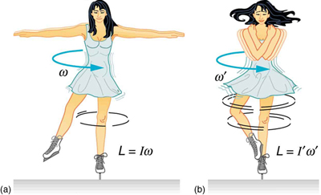
Conservation of Angular Momentum
When an ice skater spinning on the tip of her skate with her arms extended; her angular momentum is conserved because the net torque on her is negligibly small. However, when she pulls in her arms, her rate of spin increases greatly, decreasing her moment of inertia. The work she does to pull in her arms results in an increase in rotational kinetic energy

Slide 40
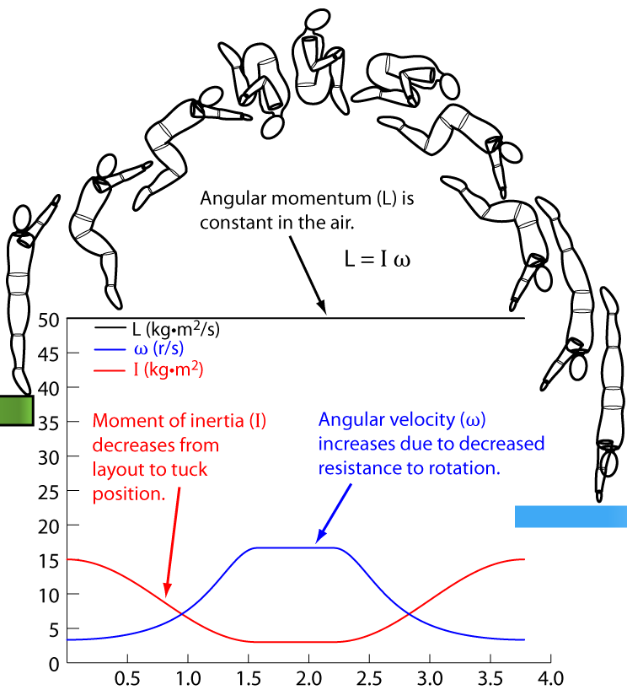

Slide 41
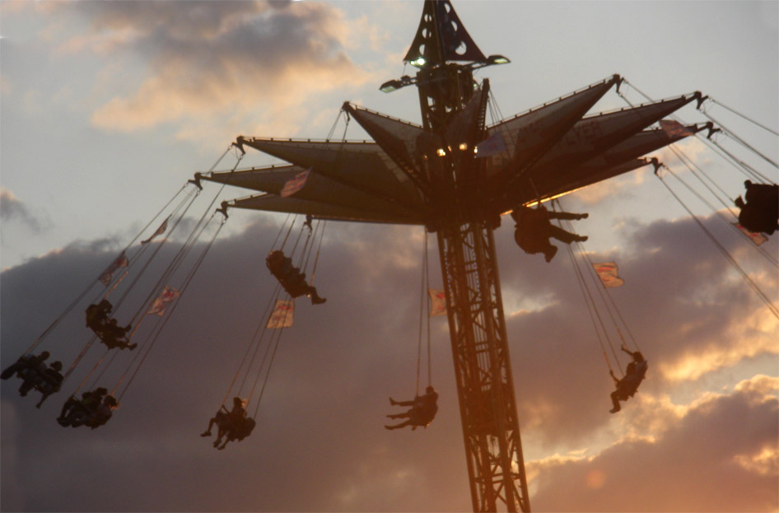

Slide 42
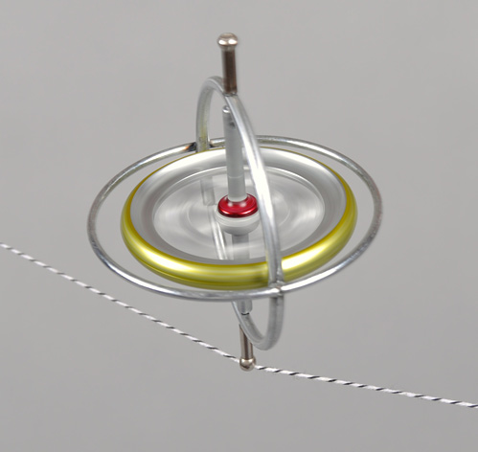

Slide 43
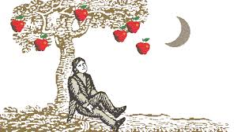
Gravity
Gravity provides the necessary downward force on our bodies which creates friction between our feet and the ground, allowing us to walk. For most purposes Newton's laws of gravity apply.

Slide 44
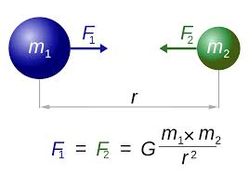
Newton's law of universal gravitation
States that any two bodies in the universe attract each other with a force that is directly proportional to the product of their masses and inversely proportional to the square of the distance between them.

Slide 45
Newton’s Law of Universal Gravitation Explained
$$F_{g}=\frac{Gm_{1}m_{2}}{r^{2}}$$
$$F_{g}=force of gravity$$
$$G=gravitational constant of 9.8m/s^{2}$$
$$m_{1}=mass of object \#1$$
$$m_{2}=mass of object \#2$$
$$r=distance between the objects$$

Slide 46
Newton’s Mountain

Slide 48
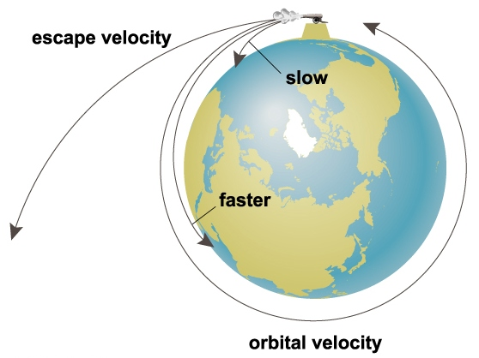
Orbital Velocity
To achieve orbit, a vehicle must accelerate from zero to a speed of almost 28,968 kilometers per hour (18,000 miles per hour), nine times faster than a bullet fired from a rifle.

Slide 49
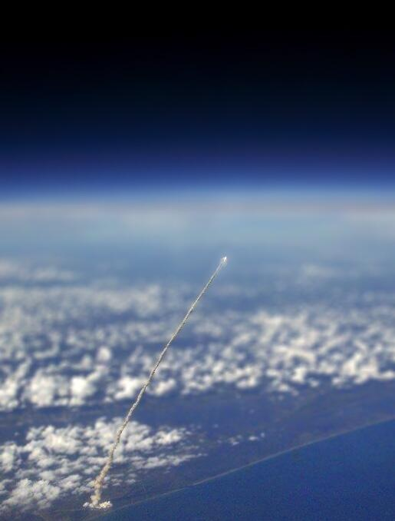

Slide 50
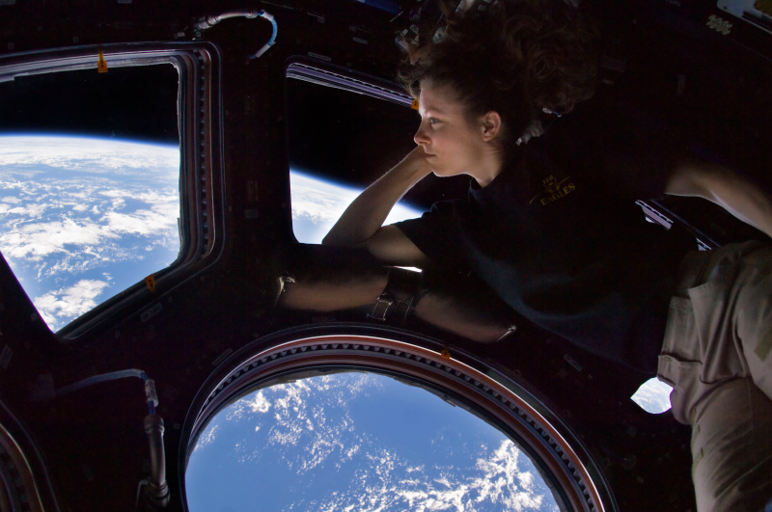
Low Earth Orbit (LEO)
Most satellites, the International Space Station and the Hubble Space Telescope are all in Low Earth Orbits. These LEOs are high enough to miss all the mountains and escape atmospheric drag.

Slide 51
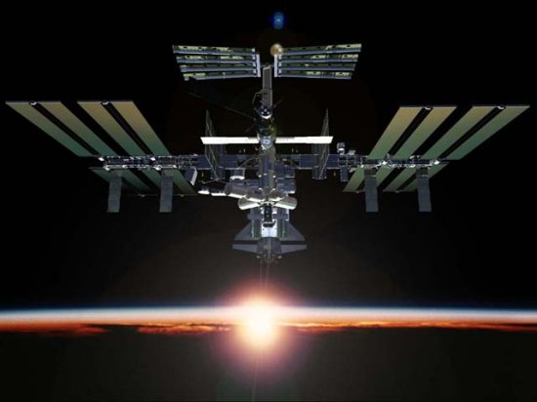
Low Earth Orbits (LEO) Continued
It takes about 90 minutes to complete an orbit around earth; therefore astronauts on the International Space Station see around 15 sunrises & sunsets every day.

Slide 52
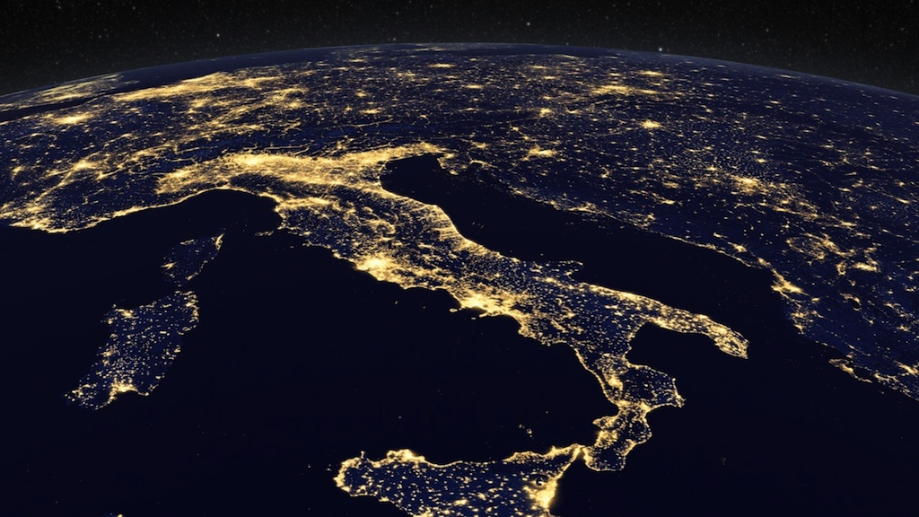

Slide 53
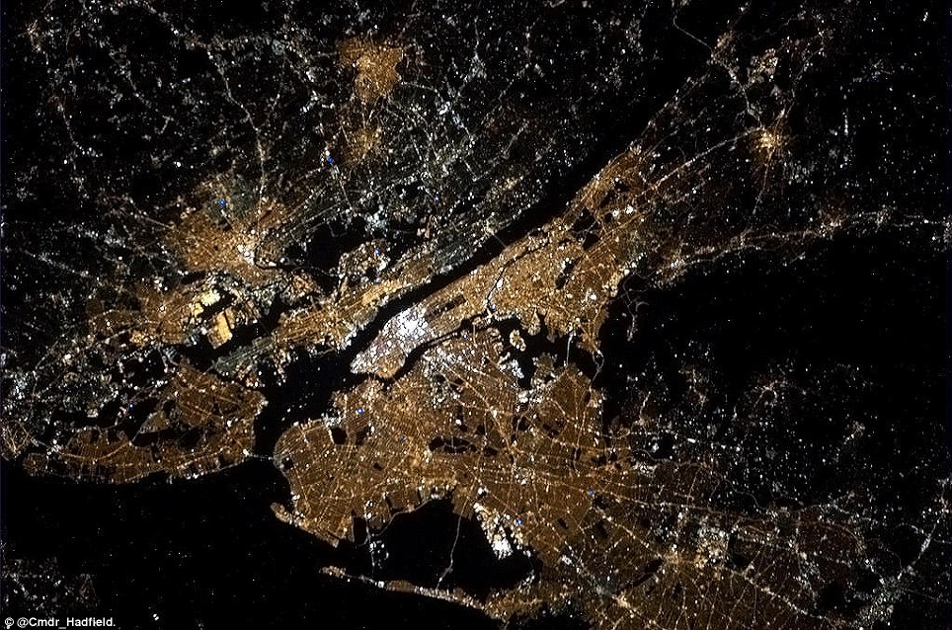

Slide 54
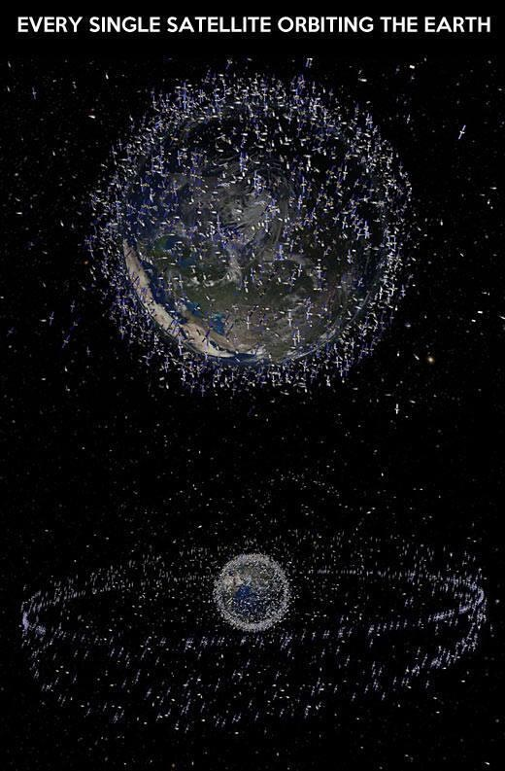

Slide 55
Escape Velocity
The minimum speed needed for a vehicle to “break free” from Earth’s gravitational attraction, or escape velocity, is about 40,270 km/h or 25,020 mph.

Slide 56
the Objective
The aim of this project is to design a carrier that will prevent an egg from breaking when dropped from a certain height. This project must adhere to the design parameters presented in class.

Slide 57
The Goals
Students will design and construct a protective egg device. Students will be able to explore the different materials available and learn to apply concepts of momentum, impulse, force and energy to this project.

Slide 58
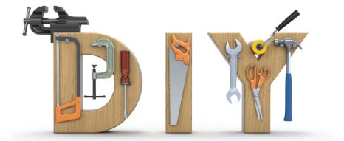
Construction
This will be an at-home project. You will not be given class-time to complete it. Good Luck!

Slide 59
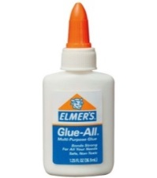
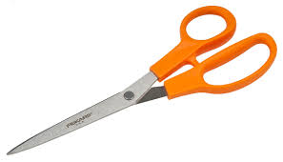
Materials Part I
The following materials will be helpful in constructing you PEV:
Glue
Scissors
Ruler

Slide 60
Materials Part II
You must choose 14 items from the following list of 24
1 sponge
6 rubber bands
5 popsicle sticks
1 meter of tape
2 sheets of construction paper
1 plastic bag
1 small cardboard box
10 straws
1 Styrofoam cup
1 tennis ball
6 cotton pads
10 Q-tips
1 empty large clean plastic jar
1 pair of socks
2 meters of toilet paper
30cm string
$8\frac{1}{2}×11$ sheet of bubble wrap
10 marshmallows
2 balloons
1 paper plate
5 pieces of tissue paper
2 sheets of plastic wrap
2 sheets of aluminum foil
3 sheets of paper

Slide 61
DESIGN PARAMETERS
No parachutes are allowed.
Only materials from the list may be used.
Raw eggs will be provided at the drop site by the teacher.
Students should be prepared and bring a small repair kit for their apparatus (i.e. tape, scissors, and left-over materials)
You may not alter the egg in any way (no tape on the egg).
The egg container and all materials must remain intact. No parts – inside or out – can fall or break off during flight or impact.
Your egg project must fit on a regular size (8 ½ x 11) sheet of paper. There is no height limit of the container as long as it fits on the paper.
The container must be able to be opened, so that we may check on the condition of the egg.

Slide 62
How to Help your Egg Survive
Try to include items to help reduce the primary impact.
Things like energy absorbing bumpers and crumple zones work well.
Next incorporate something into your design that will help absorb the secondary impact. Bubble wrap and other cushions of air work well in this situation.
Kinetic energy is the energy that a body possesses as a result of its motion.
Potential energy is the energy that exists in a body as a result of its position or condition.
When constructing your PEV, you should think about how the energy is converted from potential energy to kinetic energy and how it will effect the vehicle and the egg

Slide 63
Drop Day Requirements
1. A typed list of your fourteen materials used to construct your vehicle and a reason you chose each material.
2. A typed three paragraph explanation on how you hope your vehicle will protect the egg.
3. Your Protective Egg Vehicle (PEV)

Slide 64
 | 0 | 1 | 2 | 3
Grammar & Organization | Lists and explanations were: handwritten, unclear, incomplete and highly disorganized. | Lists and explanations were: handwritten, unclear, and disorganized. | Lists and explanations were: typed, somewhat clear and a little disorganized. | Lists and explanations were: typed, clear, coherent and easy to follow.
Design & Creativity | Student displayed zero effort and put no thought into the design of the vehicle. Nor did the student demonstrate a clear understanding of the concepts required to protect the egg. | Student displayed some effort and put a little thought into the design of the vehicle. The student demonstrated some knowledge of the concepts required to protect the egg. | Student displayed much effort and put much thought into the design of the vehicle. The student demonstrated much knowledge of the concepts required to protect the egg. | Student displayed great effort and put detailed thought into the design of the vehicle. The student demonstrated an obvious knowledge of the concepts required to protect the egg.
Materials | Student used no materials from the provided list and completely ignored the design parameters. | Student used few materials from the provided list and exceeded the design parameters. | Student used some materials from the provided list and slightly exceeded the design parameters. | Student adhered to the materials list and stayed within the design parameters.
Egg Safety | Vehicle allowed the egg to break. | Vehicle allowed the egg to crack and leak a little. | Vehicle allowed the egg to crack. | Vehicle completely protected the egg.

Slide 65
Score | Grade
10 – 12 | A
8 – 9 | B
6 – 7 | C
4 – 5 | D
2 – 3 | F
0 – 1 | F-

Slide 66
Possible Designs
Protective Egg Vehicles (PEVs)

Slide 72
El Fin
Good Luck

