Slide 1
The Rube Goldberg Machine
A Desktop Project

Slide 2
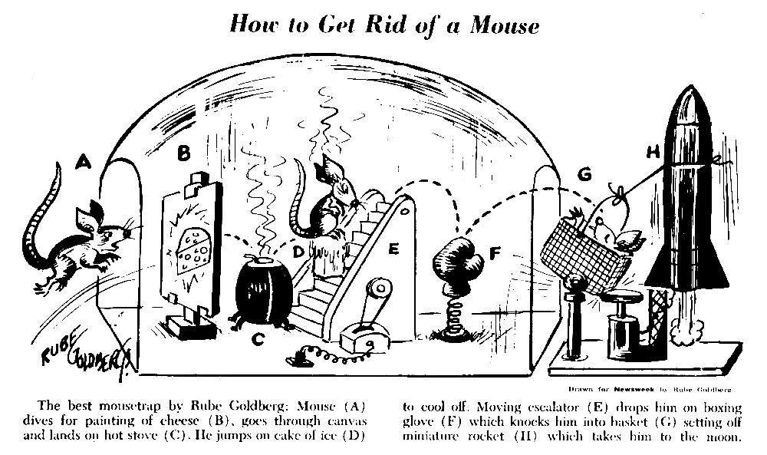

Slide 3
Rube Goldberg
Reuben Goldberg (July 4, 1883 – December 7, 1970) was an American cartoonist, sculptor, author, engineer, and inventor.
He is best known for a series of popular cartoons depicting complicated gadgets that perform simple tasks in indirect, convoluted ways.
Rube Goldberg was born July 4, 1883, in San Francisco, California, He was the third of seven children. Rube began tracing illustrations when he was four, he like it so much that he began to take professional drawing lessons at eleven years old.
His father wanted Rube to pursue a career in engineering. So he attended and graduated from the University of California, Berkeley in 1904 with a degree in Engineering. He was then hired by the city of San Francisco as an engineer for the Water and Sewers Department. After six months, however, he resigned his position with the city to join the San Francisco Chronicle as a sports cartoonist. Rube moved to New York City in 1907, and became a cartoonist for the New York Evening Mail. By 1915 he was earning $25,000 per year and was America's most popular cartoonist.
In the late 1960s and early 70s, educational shows like Sesame Street, Vision On and The Electric Company routinely showed bits that involved Rube Goldberg devices, including the Rube Goldberg Alphabet Contraption, and the What Happens Next Machine. Goldberg died in 1970 at the age of 87.

Slide 4
What is a Rube Goldberg Machine?
A Rube Goldberg machine is a contraption, invention, device or apparatus that is deliberately over-engineered or overdone to perform a simple task in a complicated fashion, usually including a chain reaction.

Slide 5
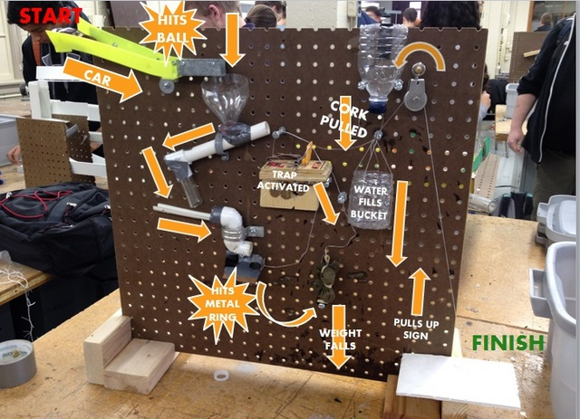
Objective
To design and build a machine that will pop a balloon in a minimum of 8 steps using simple machines. Use the information learned in class and your creativity to build your Rube Goldberg machine.

Slide 6
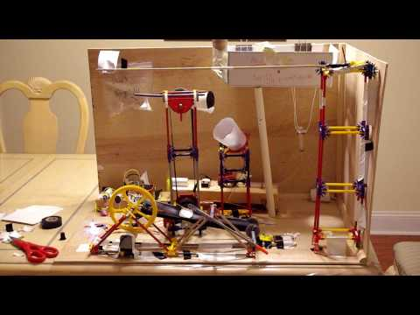
Design Parameters
Be no larger than 17” long, 22” wide and a maximum of 36” in height.
Have the simple machine names labeled on your machine.
Use all 6 simple machines (Lever, Pulley, Inclined Plane, Wheel and Axle, Wedge and Screw).
You can only touch your device one time in the beginning.

Slide 7
Simple Machines
Simple machines are devices that can make a tough job easier by enabling a person to apply less force or to apply force in a direction that is easier to manipulate. There are six types of simple machines: lever, pulley, inclined plane, wedge, screw, and wheel and axle.

Slide 8
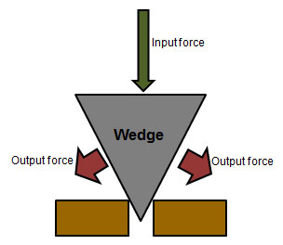
Wedge
It is made of two inclined planes and can move. The point of contact of the two inclined planes results in a sharp edge which can be used to cut and split objects and to hold them together. A wedge is shaped in such a manner that it is triangular in appearance. Examples of wedges that we use in daily life include forks, knives, and even our teeth.

Slide 9
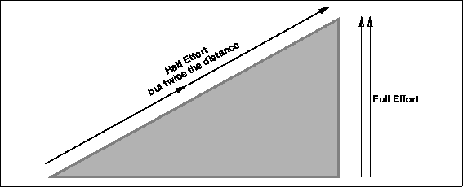
Incline Plane
An inclined plane can either help to lift or lower an object. It is made up of a flat plane that is inclined at one end. Moving an object on an inclined or slanted surface is much easier than a straight surface.

Slide 10
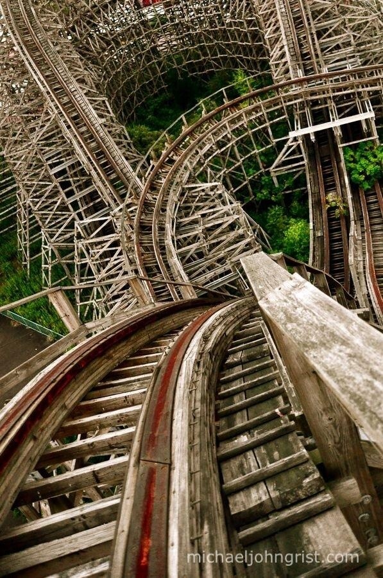
How about this inclined plane…

Slide 11
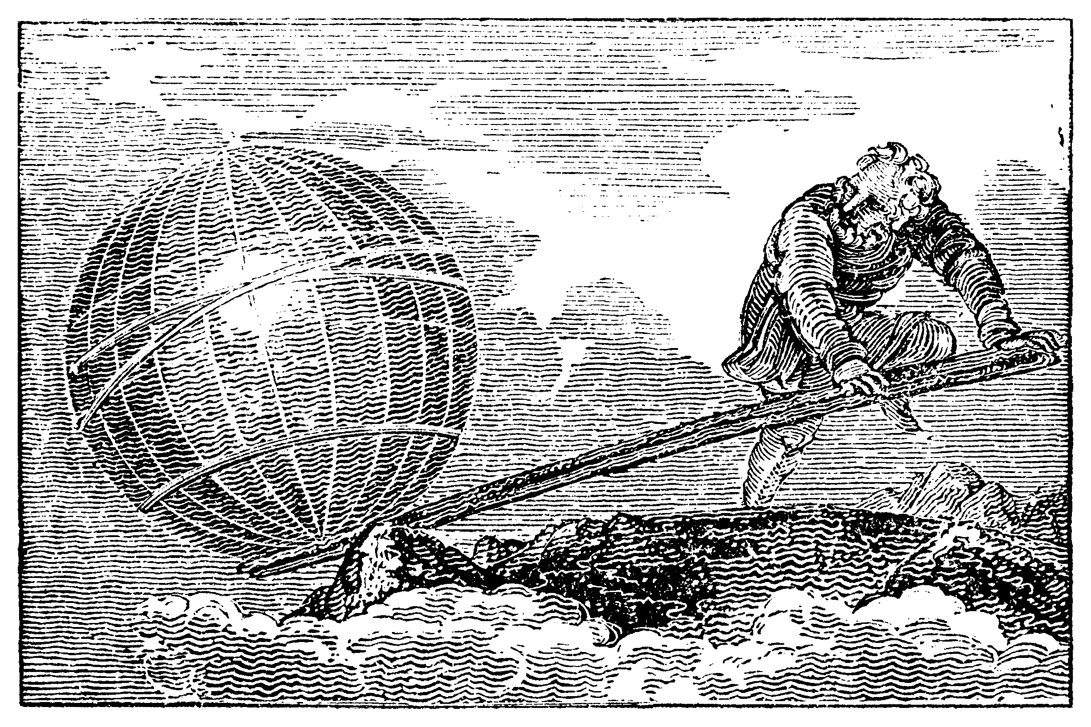
Lever
The lever which is a bar-like rigid object moves against a turning point to move a third object. The turning point against which it moves is known as the fulcrum and the closer the object that needs to be moved is to the fulcrum, the easier it is to move the former. There are three types of levers; first-class lever, second class lever, and third class lever.
“Give me a lever long enough and a fulcrum on which to place it, and I shall move the world.”
- Archimedes

Slide 12
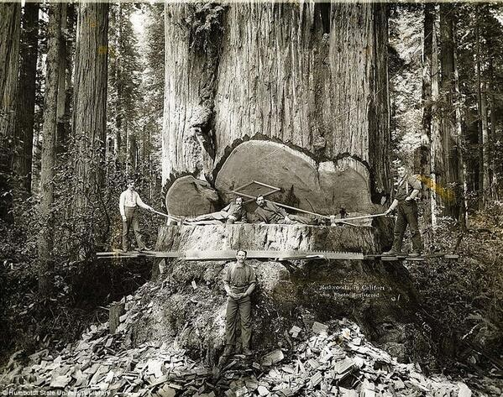
Another Cool Lever

Slide 13
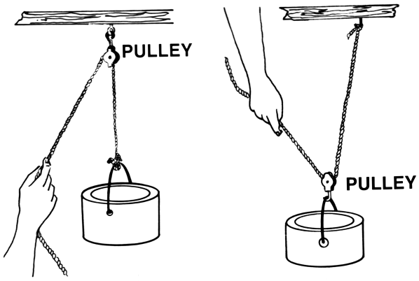
Pulley
In this simple machine one end of a cord is attached to the load that needs to be moved, placed over a wheel and as you pull on one side, according to the direction in which you exert force, you can move the load forward or backward. If you are looking for interactive simple machines, then try to make a model of a flag which is being hoisted. It uses the pulley system.

Slide 14
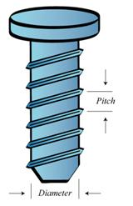
Screw
Many people consider screw to be a modified version of the inclined plane which differs in shape because of its helical appearance. It uses the principle of transfer of energy, converting rotational force into linear force in the process of performing a task. On one end of an inclined plane is a helical and on the other end is a provision that you can use to turn it. Screws are used to hold objects together and even to raise weights.

Slide 15
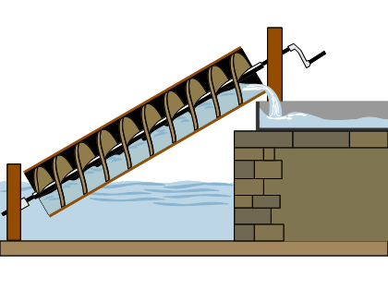
Archimedes Screw

Slide 16
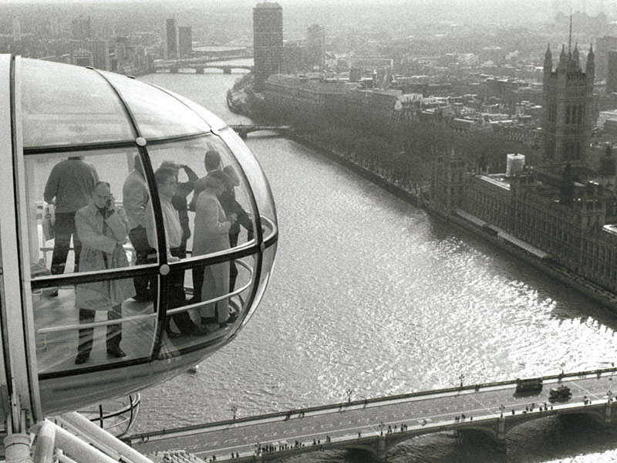
Wheel and Axle
The axle is the rod that is speared through the wheel to rotate it. The axle converts rotational force into linear force propelling the object forward. There are many games that you can play to explain the concept of the wheel and axle. You can use simple toys to explain the principle of this simple machine.

Slide 17
Our Rube Goldberg Machines

Slide 18
A pulley, wedge and inclined plane…

Slide 19
It doesn’t have to be fancy…

Slide 20
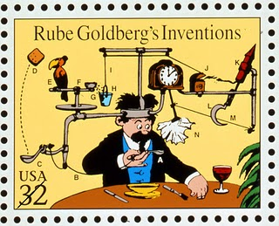
Due Dates
Original sketch or a rough drawing of how you think your machine will operate.
Date: _______________
Final diagram of machine built.
Date: _______________
A competed functional Rube Goldberg machine.
Date: _______________
Typed step-by-step process of how your machine works. You can use bullets or numbers.
Date: _______________

Slide 21
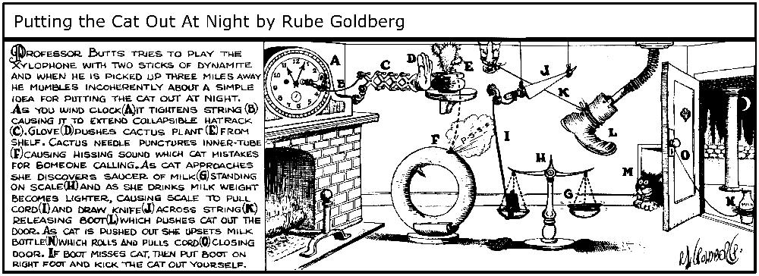
Desktop Rube Goldberg Machine Grading Rubric
Use all 6 simple machines (30 points possible)
Inclined Plane (5 points)
Lever (5 points)
Pulley (5 points)
Screw (5 points)
Wedge (5 points)
Wheel and Axle (5 points)
Perform a minimum of 8 steps from start to finish (40 points possible)
Completes step one (5 points)
Competes step two (5 points)
Completes step three (5 points)
Completes step four (5 points)
Completes step five (5 points)
Completes step six (5 points)
Completes step seven (5 points)
Completes step eight (5 points)
Machine succeeds in popping the balloon (10 points possible)
Pops balloon 1st try (10 points)
Pops balloon 2nd try (8 points)
Pops balloon 3rd try (6 points)
Pops balloon 4th try (4 points)
Pops balloon 5th or more attempts (2 points)
Doesn’t pop balloon (0 points)
Written work complete (20 points possible)
Rough Sketch (5 points)
Final Sketch (5 points)
Typed Step-by-step process (10 points)

Slide 22
Notebook Test
When was Rube Goldberg born?
What did he love to do as a young person?
What was Rube Goldberg’s first job?
How long did it last?
When he moved to New York what did he do for a living?
What is a Rube Goldberg Machine?
Name the six simple machines.
Give two examples of a wedge.
In your own words describe a fulcrum.
An axle converts ______ force into _____ force propelling the object forward.

